Slide 1
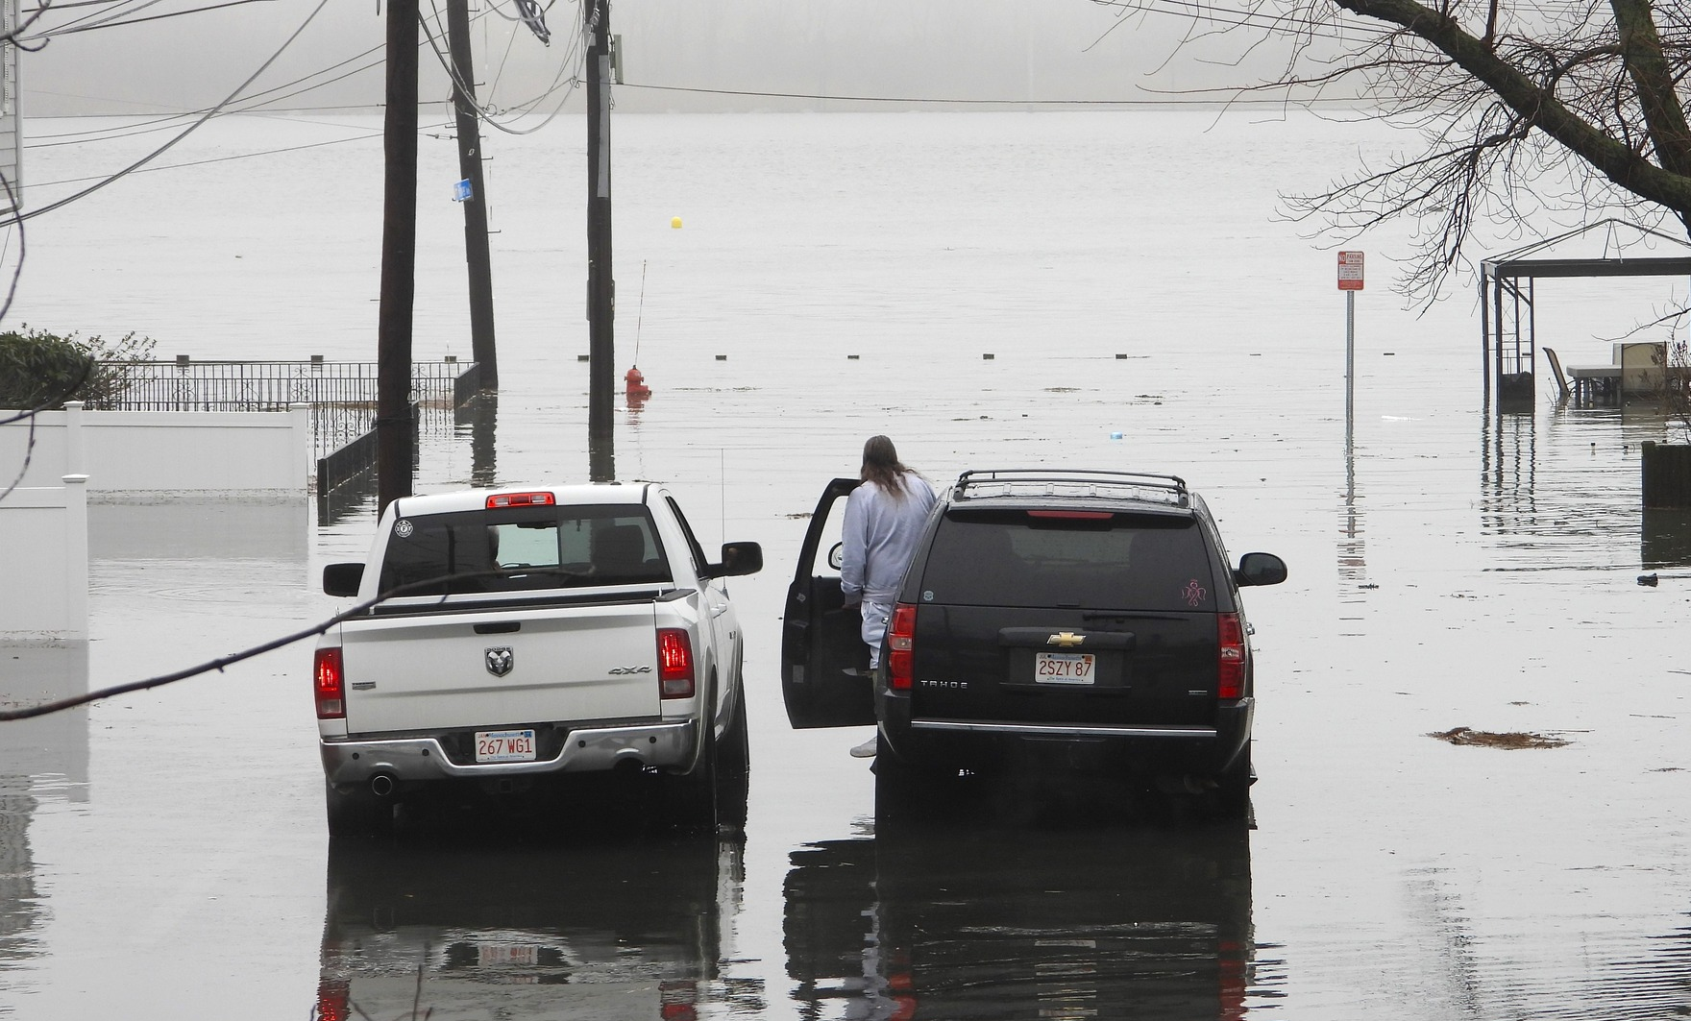
Building Adaptive Capacity in Revere: Flood Monitoring and Community Resilience Project
Community Meeting
04/15/2026
Photo Credit: Ricci LaCentra (01/13/2024)

Slide 2
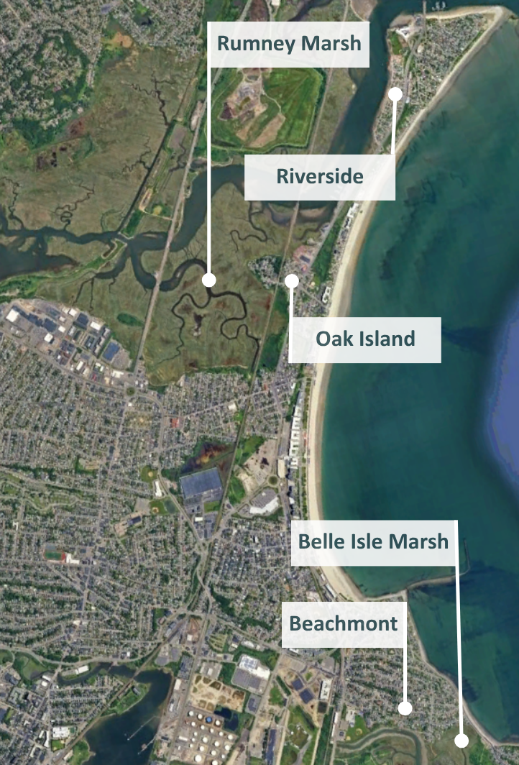
What Led to This Work
Evidence of Past and Ongoing Flooding
  Residents in low-lying areas of the Riverside and Beachmont neighborhoods have experienced recurring flooding.
Community Input
  Public input has helped identify the need for better flood information, early warning tools, and near-term actions.
Previous Planning and Resilience Studies
  Belle Isle Marsh Environmental Inventory, Coastal Modeling, and Restoration Assessment (2022)
  Saugus River Watershed Coastal Vulnerability Assessment and Regional Adaptation Plan (2023)
  Saugus River Watershed Shoreline Prioritization and Adaptation Project (2024)
  Building Resilience in Beachmont Plan (2025)

Slide 3
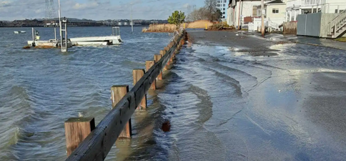
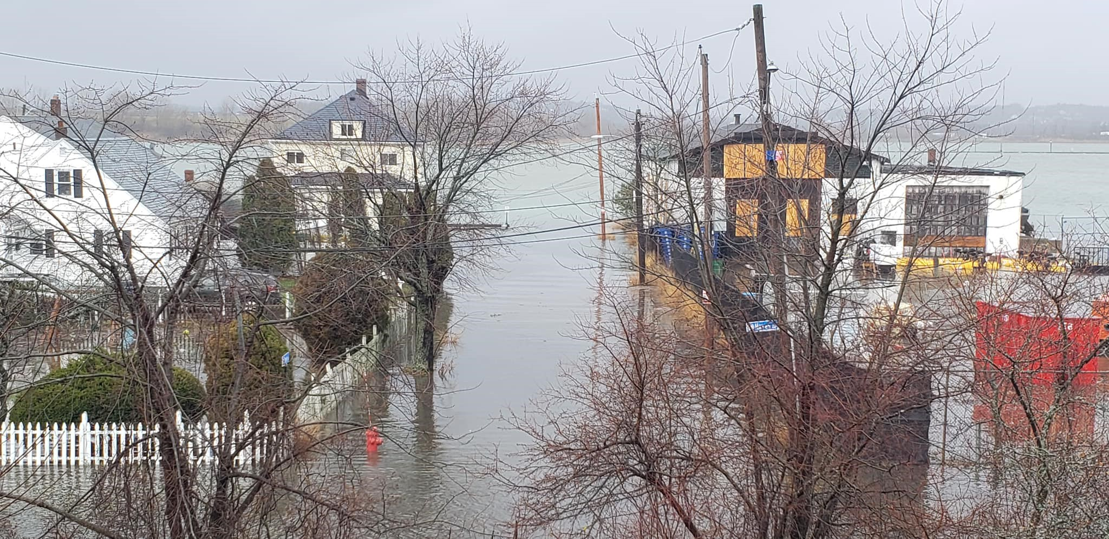
Primary Types of Flooding
Storm-induced flooding occurs during coastal storms when elevated water levels, storm surge, and wave action combine with the natural tide cycle.
Sunny-day flooding occurs during high tides, even when weather conditions are calm. This type of flooding is driven by:
  High astronomical tides
  Rising sea levels
  Local low points where water begins to enter streets or properties
Photo Credit: MyCoast
Photo Credit: Lauretta LeCentra

Slide 4
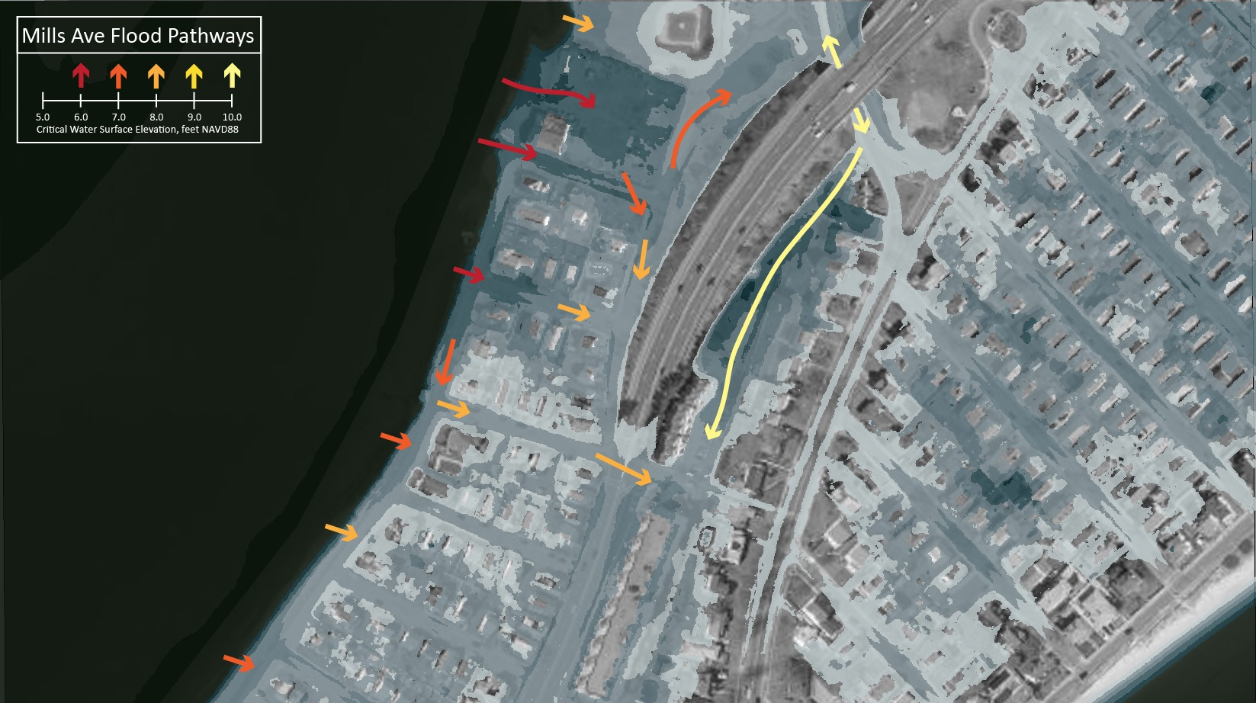

Slide 5
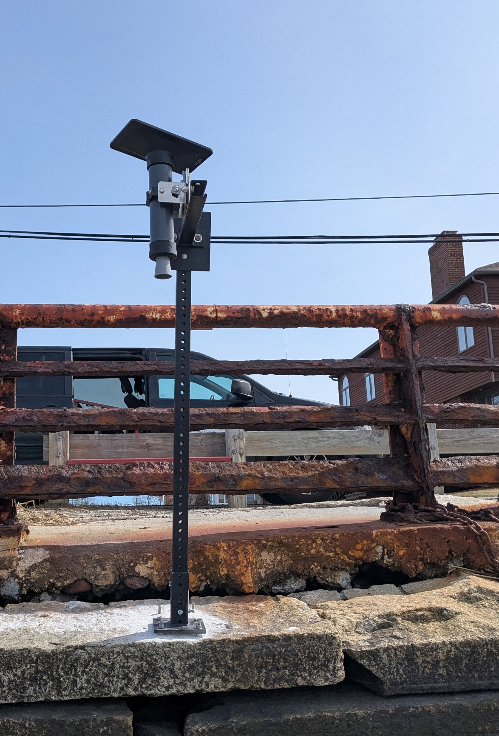
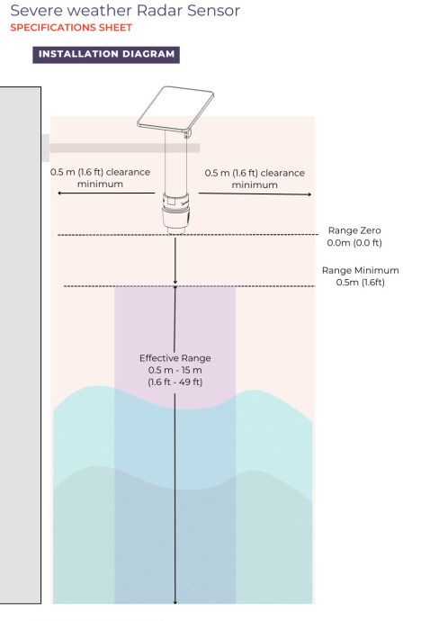
Monitoring Flooding in Real Time
To better understand when these flooding thresholds are reached, we are also using real-time monitoring.
Hohonu sensors are compact, solar-powered flood monitoring devices that measure water levels in real time.

Slide 6
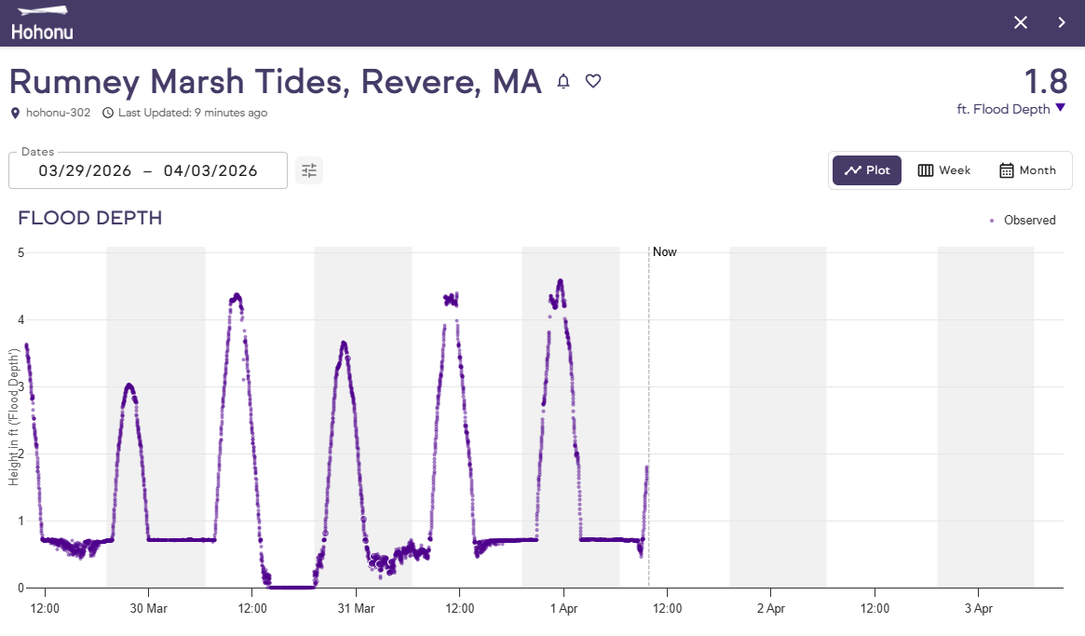
How the Sensors Will Help Us
Measure water surface elevation at regular intervals
Record tides, storm surge, and flooding events over time
Send data wirelessly to an online dashboard
Trigger alerts when water reaches predefined thresholds
https://dashboard.hohonu.io/

Slide 7
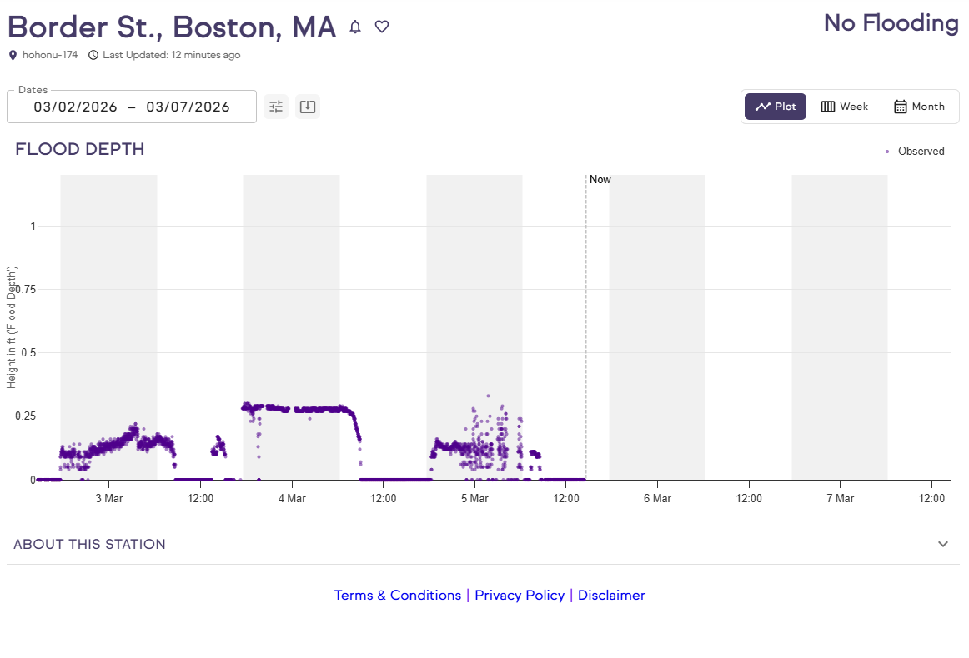
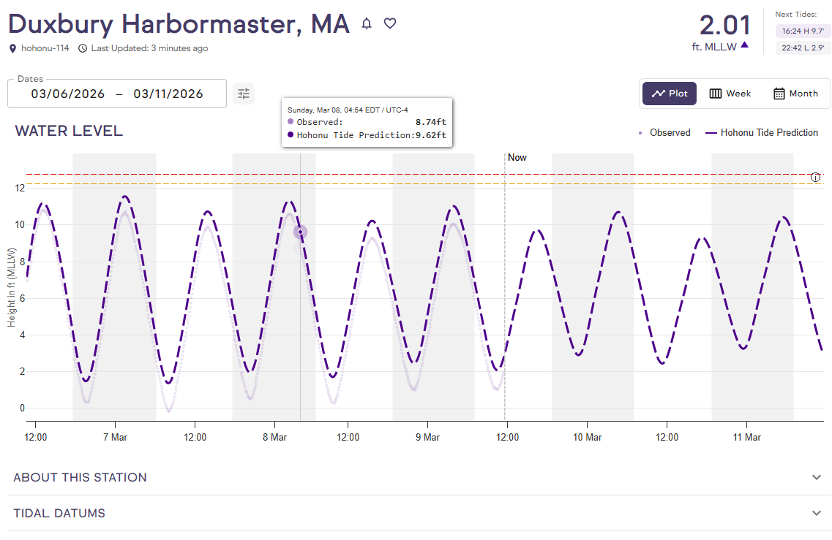
Types of Sensors We’ve Installed
https://dashboard.hohonu.io/

Slide 8
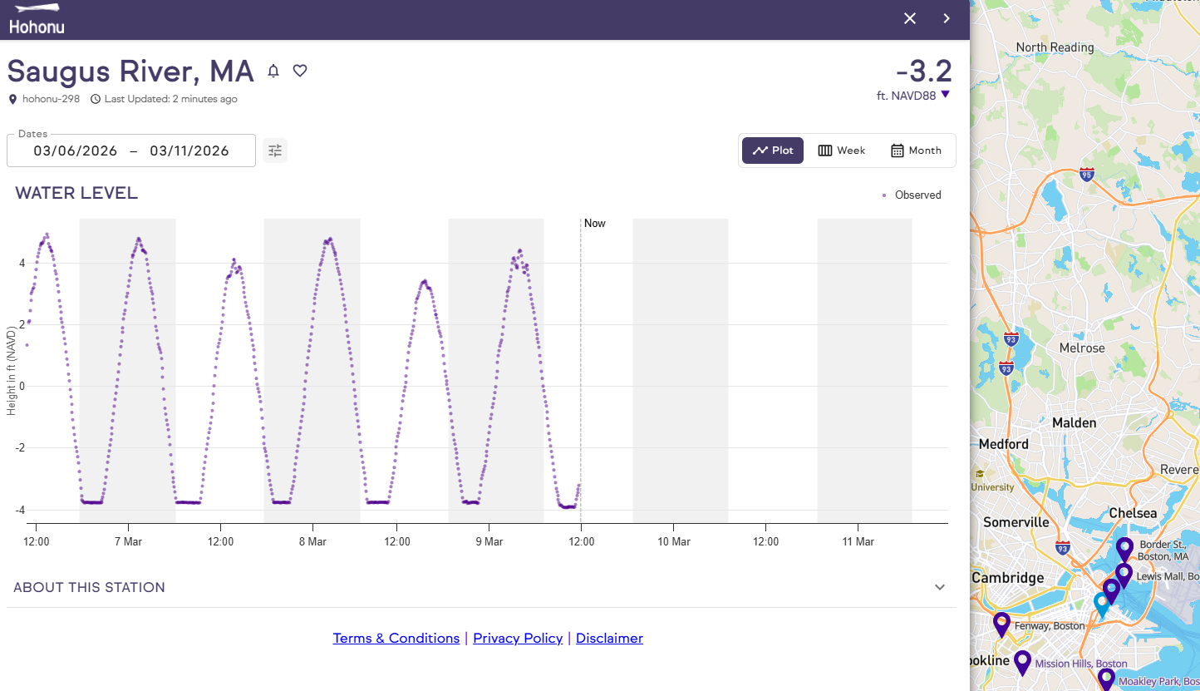
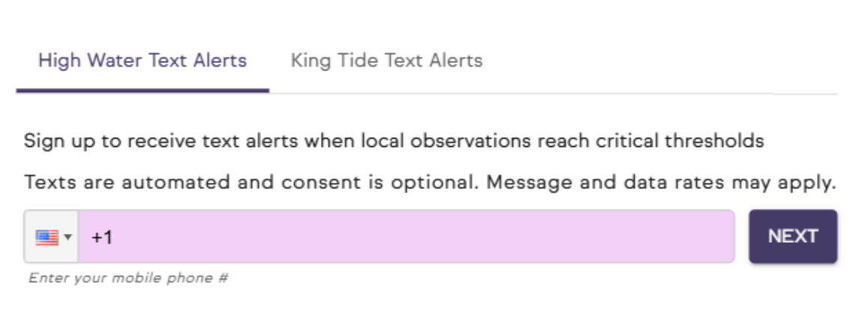
Come See Us to Learn How to Sign Up for Text Alerts
https://dashboard.hohonu.io/

Slide 9
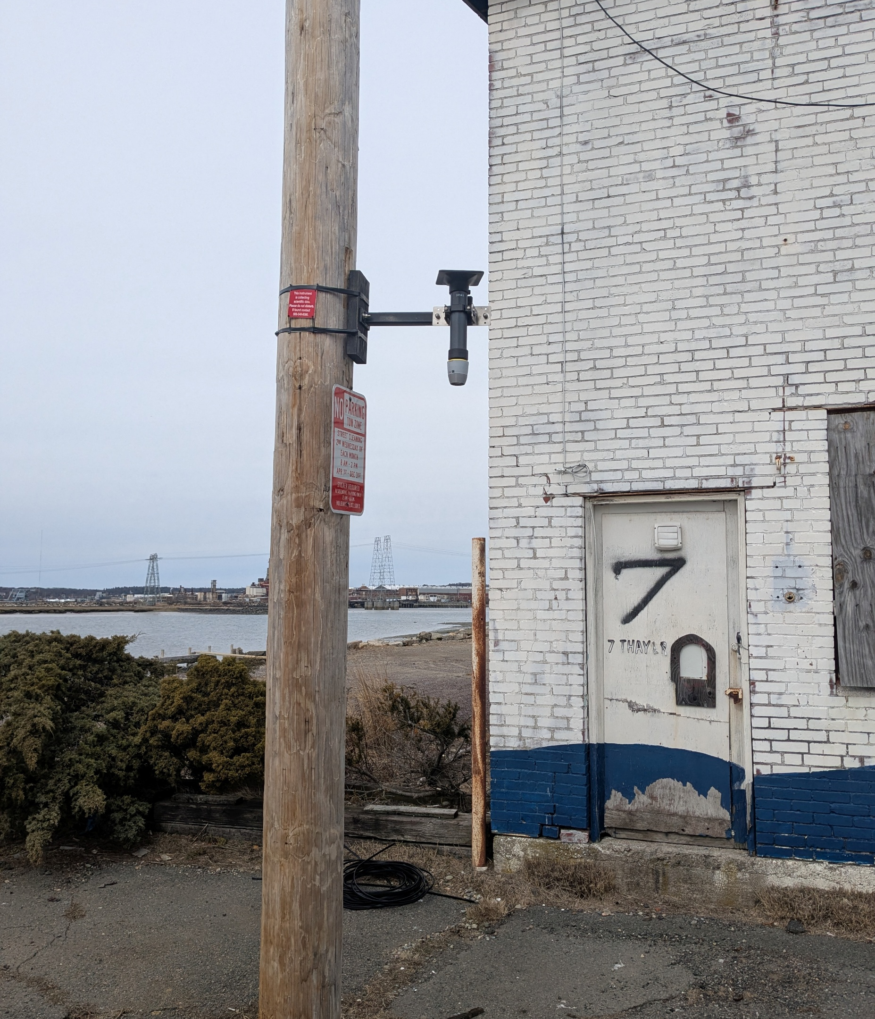
Thank You
Contact Information:
Kristen Homeyer khomeyer@revere.org
Justine Rooney Jrooney@woodsholegroup.com

