Slide 1
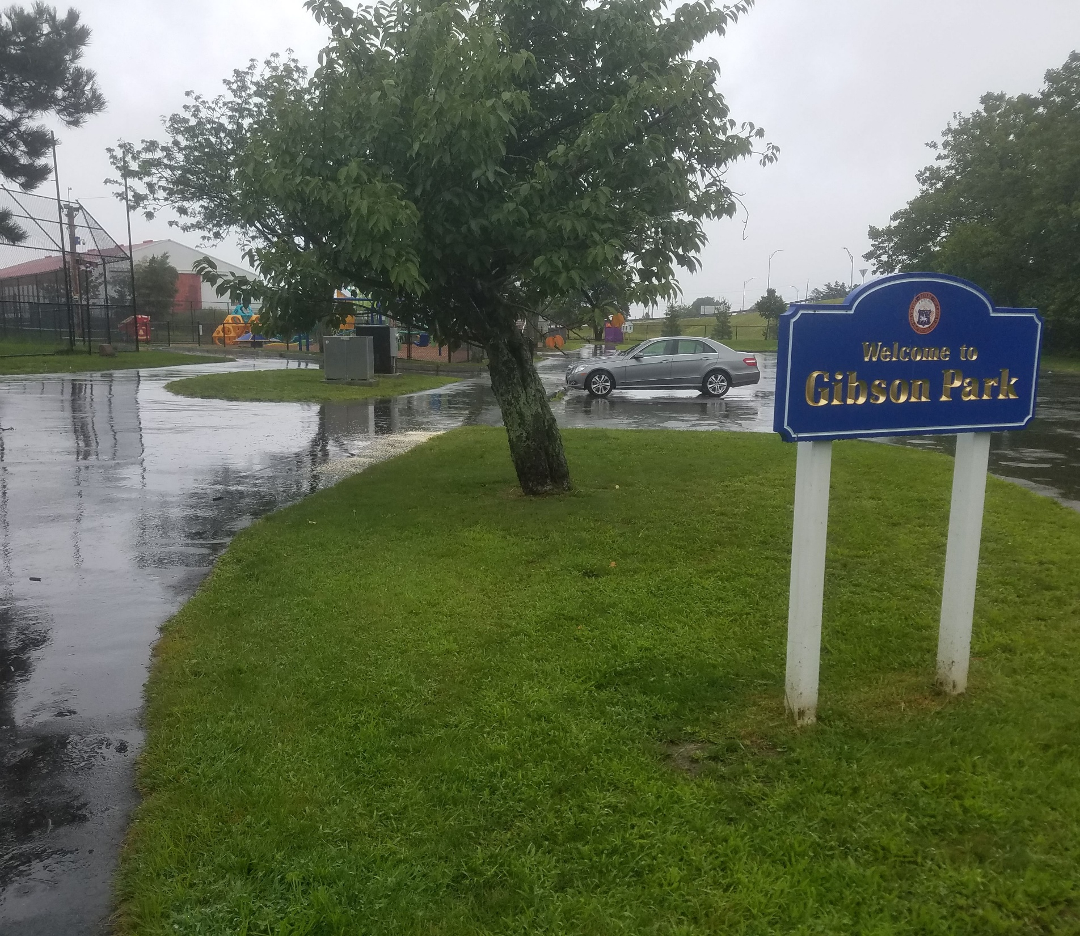
Gibson Park Recreation Expansion Project
City of Revere – Riverside Neighborhood
April 15, 2026

Slide 2




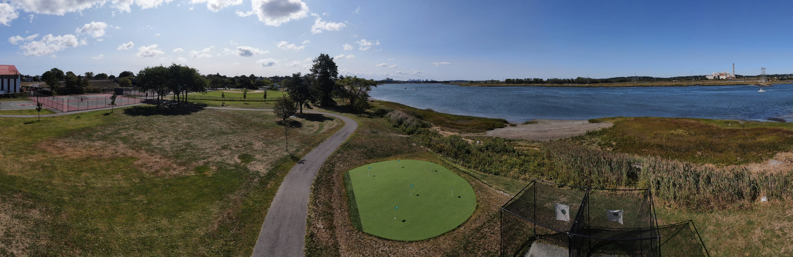
Project Team:
• City of Revere, DPCD
• McAllister Marine Engineering, LLC
• Copley Wolff Design Group - Landscape Architecture
• LEC Environmental - Environmental Resources
• Heimlich Landscaping & Construction Corp

Slide 3
Existing Conditions of Project Area
Looking South from Northern Portion of the Park

Slide 4
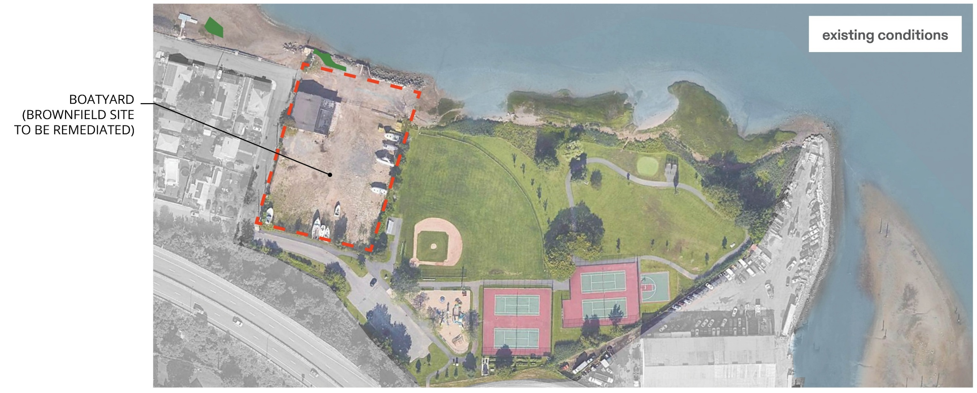
EXISTING LAYOUT
PHASE II

Slide 5
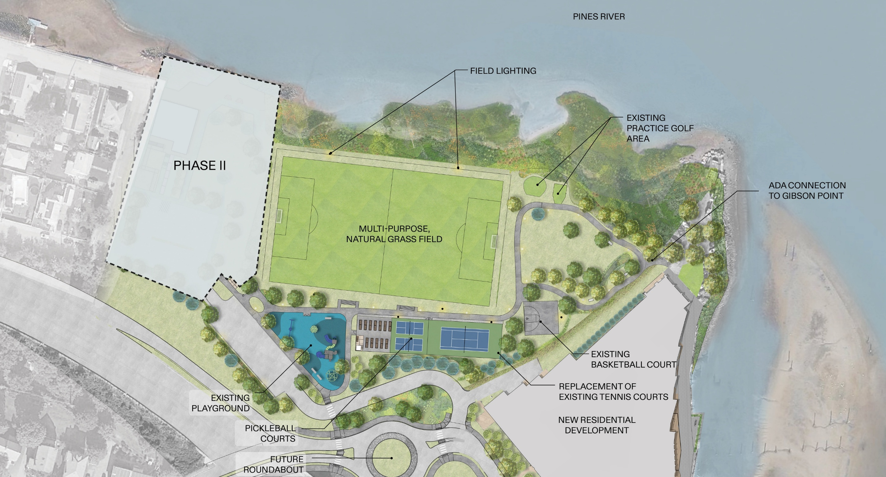
PROPOSED LAYOUT

Slide 6
Phase 1 Improvements
A 360-foot x 220-foot (79,200 square foot) multi-purpose grass athletic field
A 4-foot-tall chain-linked fence will be installed around the shoreline side of the field
Existing paved walking paths will be updated
The existing four tennis courts will be removed and replaced with two stacked tennis courts
Two, three (3) tiered metal bleachers will be installed
High mast lighting will be installed around the perimeter of the multipurpose field
Existing features to remain in place include the basketball court, playground, practice golf area, and paved parking lot.
Pickleball Courts will be installed adjacent to the relocated community gardens
Existing Memorial Benches will be relocated within the Park

Slide 7
Tentative Project Timeline
The project start date is Contingent on the NEPTES permit
Late April 2026-Mobilization and Set up
May – August 2026 -Site Work and Utility Activities
September- October 2026 Planting, seeding, Park Amenities
November –Demobilization
General Information
Park will be closed during Construction for Public Safety
The entire construction site will be fenced off
Work crews will park at the Site, not on neighborhood roads
Contractor to obey local speed restrictions
Hours are 7 a.m. to 4 p.m. weekdays
Sunday work will require approval from the City

Slide 8
Future Activities
29 Thayer Work
  Dependent on Environmental Remediation
  Grant application submitted for a Brownfield Clean Up Grant- The city should hear back in June 2026
Roundabout Tie-in
  Future connection in from the north that will cur off traffic coming through the Riverside Neighborhood

Slide 9
Thank you !
Follow project updates at https://www.revere.org/ongoing-initiatives

