Slide 1


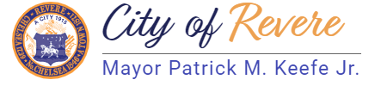
Revere Composting Program
Curbside Compost in Partnership with Garbage to Garden
Abderezak Azib Sustainability Manager

Slide 2

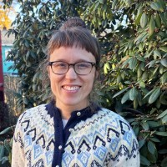
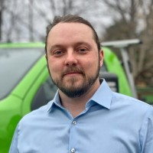

MEET THE TEAM
Abderezak Azib
Sustainability Manager
Kristen Homeyer
Municipal Programs Manager GTG
Tyler Frank
President GTG

Slide 3

Project Overview
Weekly curbside compost collection
Food scraps diverted from trash
Service for all housing types

Slide 4
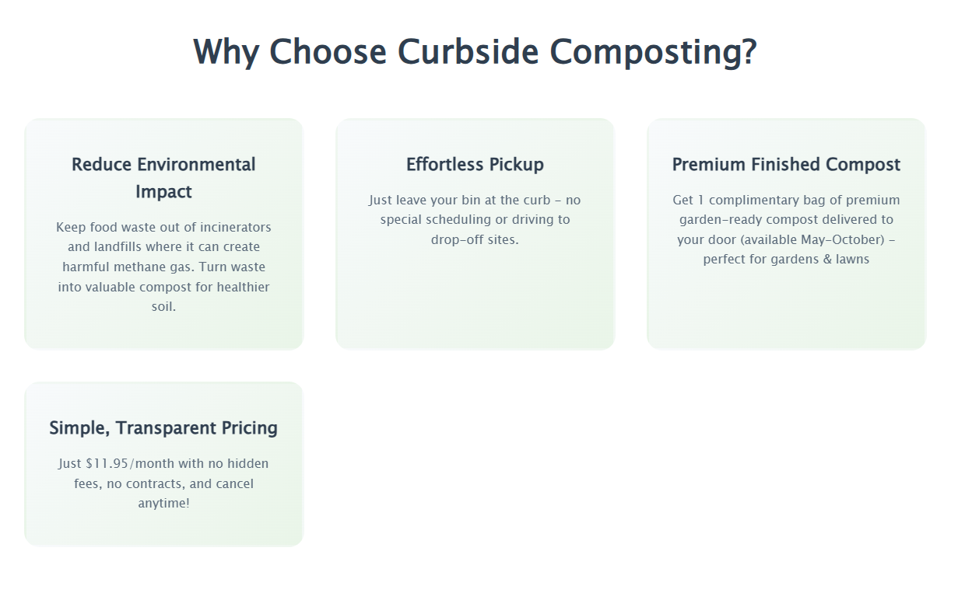
Project Goals

Slide 5
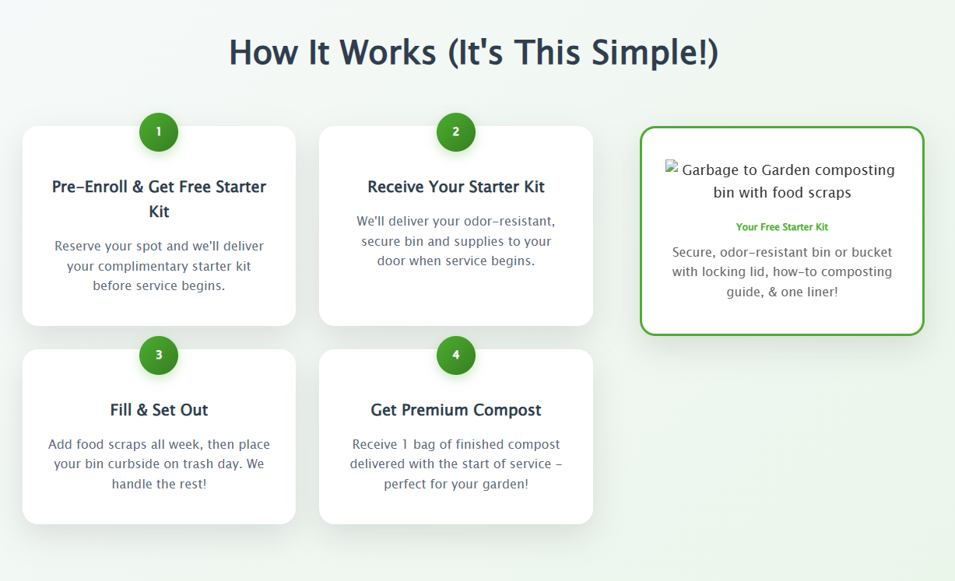
How it works

Slide 6
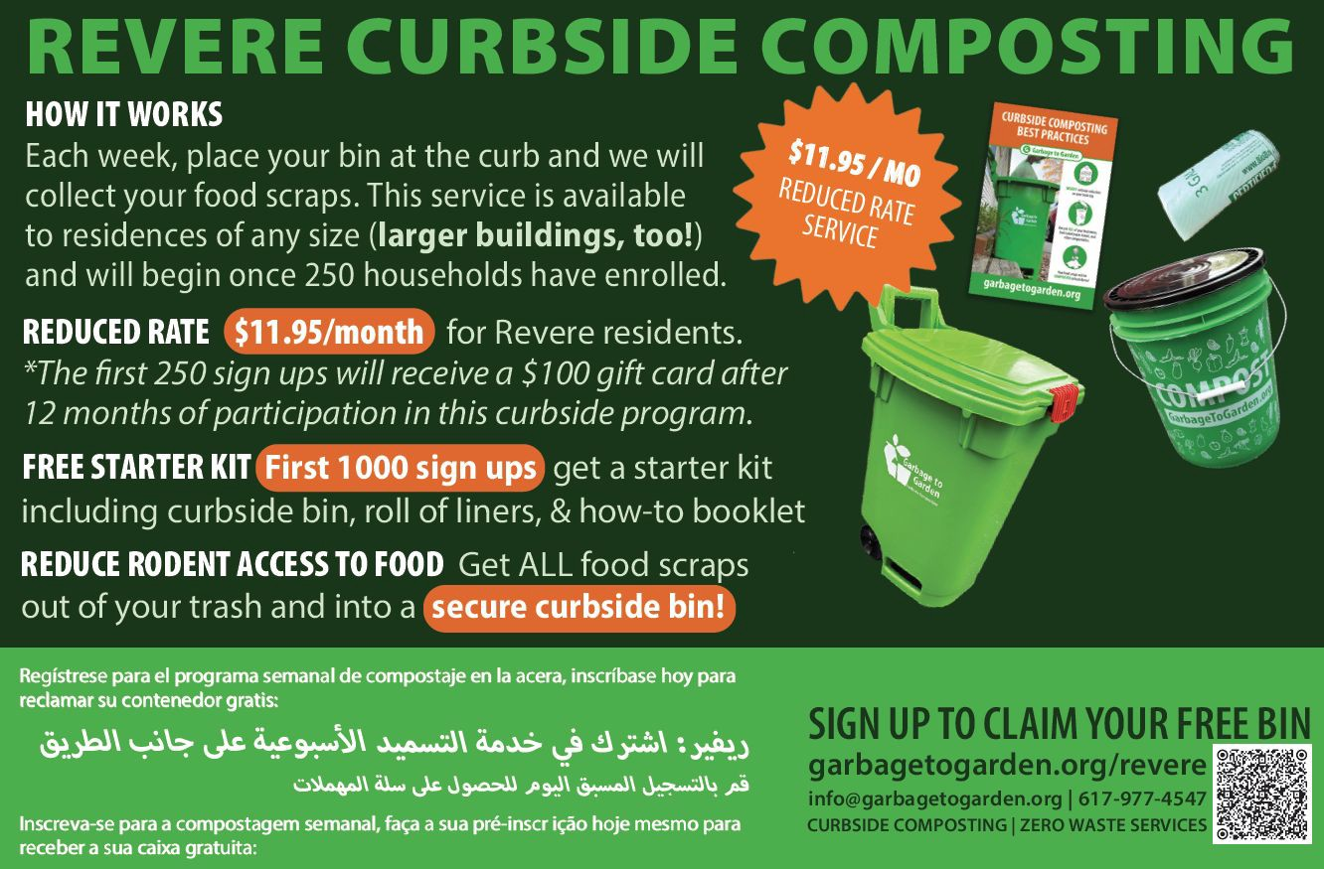

Program Details
Notes:
Program ready
~100 households signed up
Goal: 250 to launch
Weekly pickup
Starter kit included
$11.95/month reduced rate

Slide 7

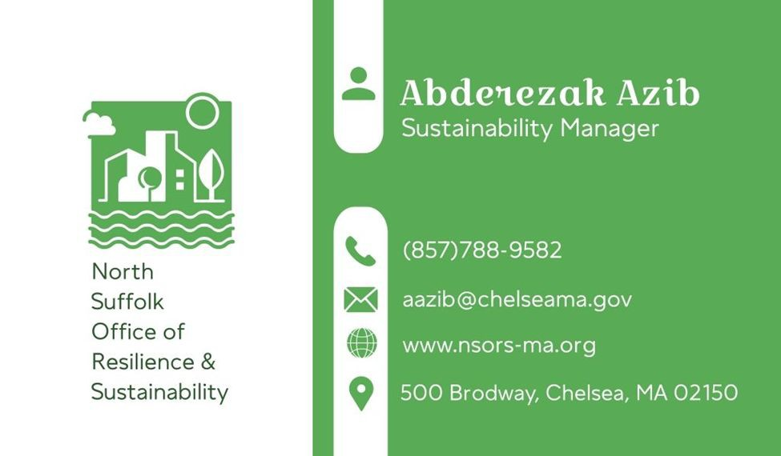
THANK YOU!

