Slide 1
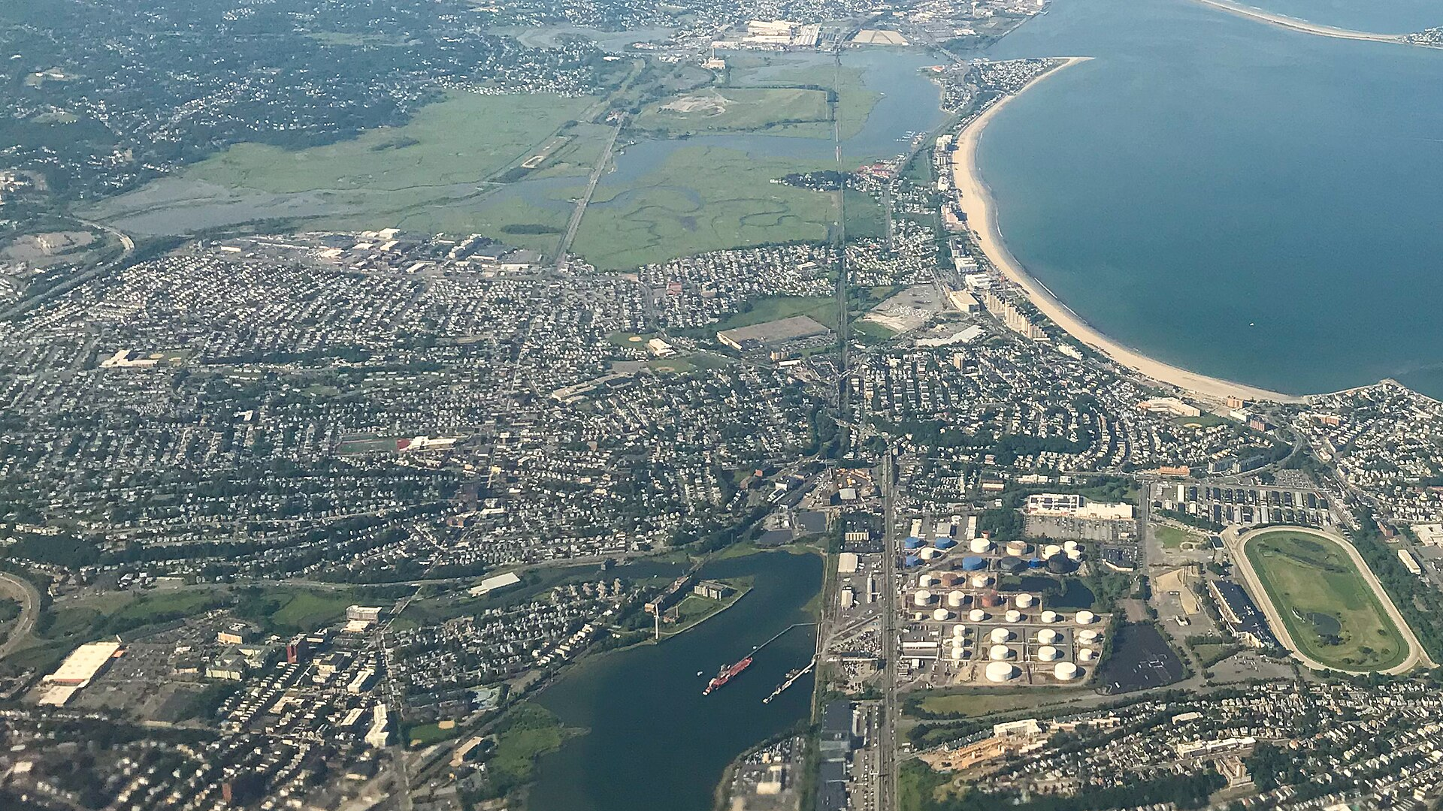


Preliminary Data Update
Initial insights from September 2020 - April 2026 air monitoring
Point of Pines Community Meeting, Revere MA
April 15, 2026

Slide 2



Scott Hersey
Co-founder
Francesca Majluf
Co-founder

Slide 3
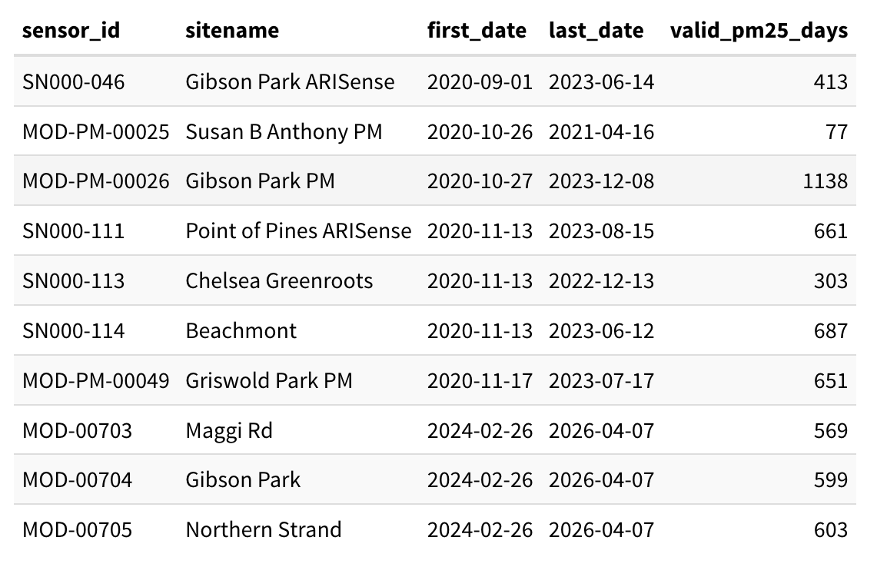
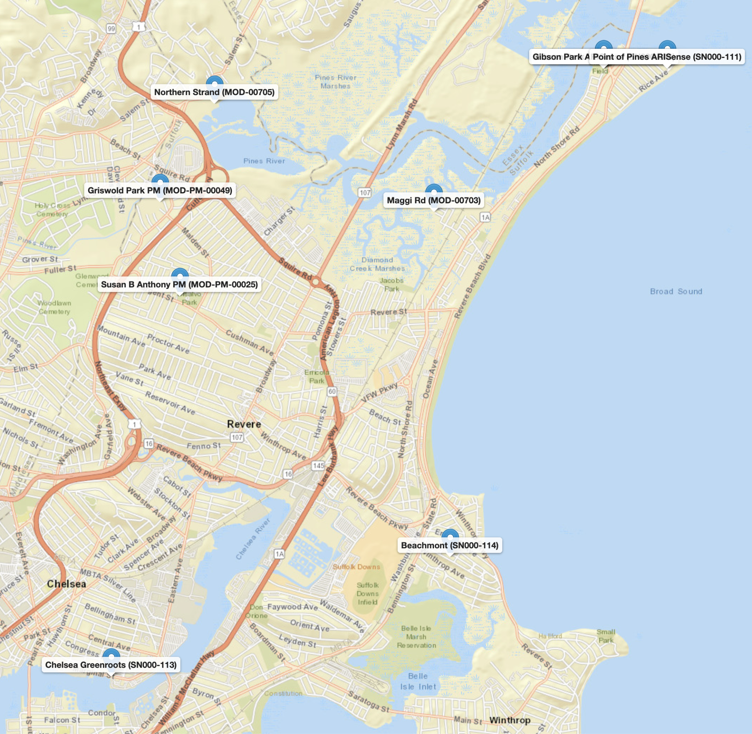
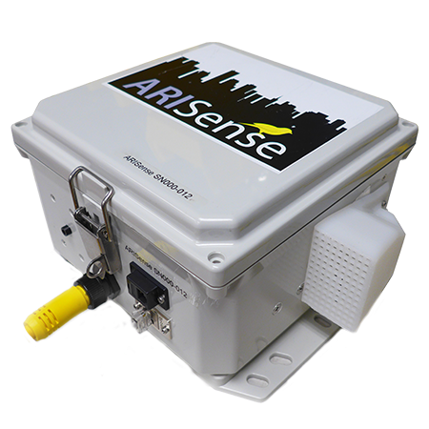
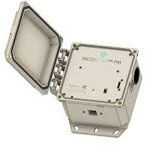
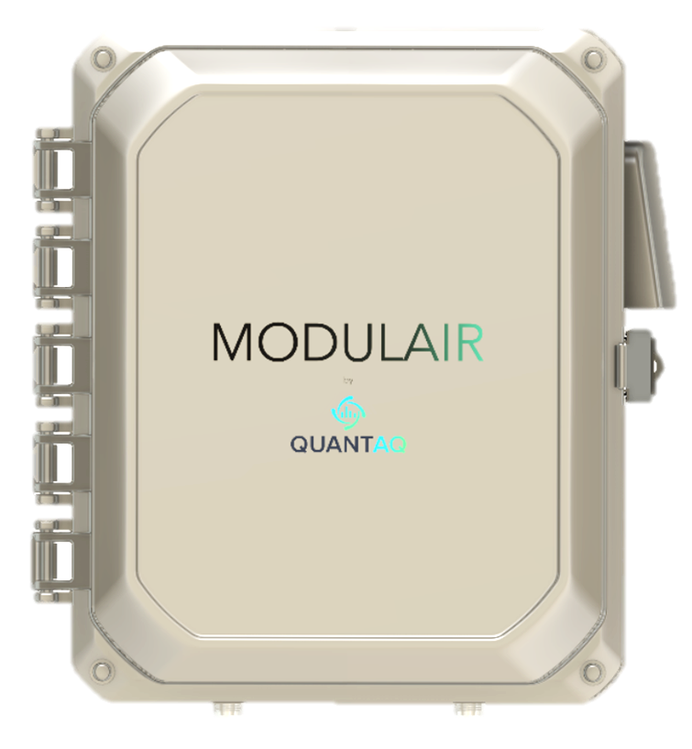

Air Quality Monitoring Network
Notes:
This information exists and here’s how you access it.

Slide 4



Air Quality Monitoring Network
Notes:
QR Codes

Slide 5
Key questions we’re going to answer
When were sensors (not) working?
When was air quality bad?
When is air quality typically bad?
Where (in a network) is air quality better or worse?
What conditions are associated with poor air quality?
Where does air pollution appear to be coming from?

Slide 6
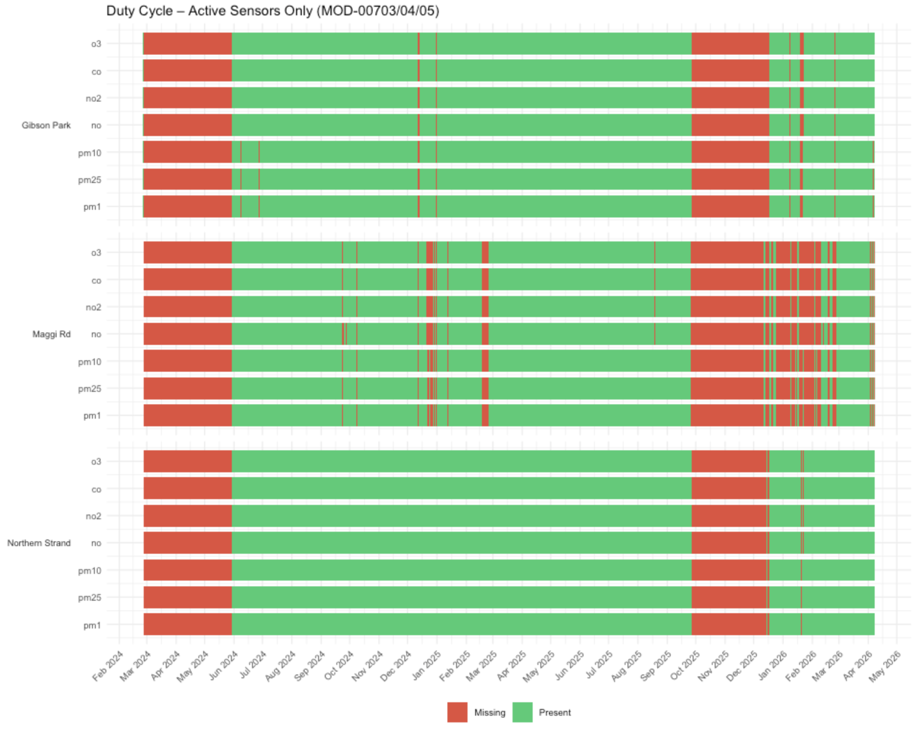
When were sensors working?

Slide 7
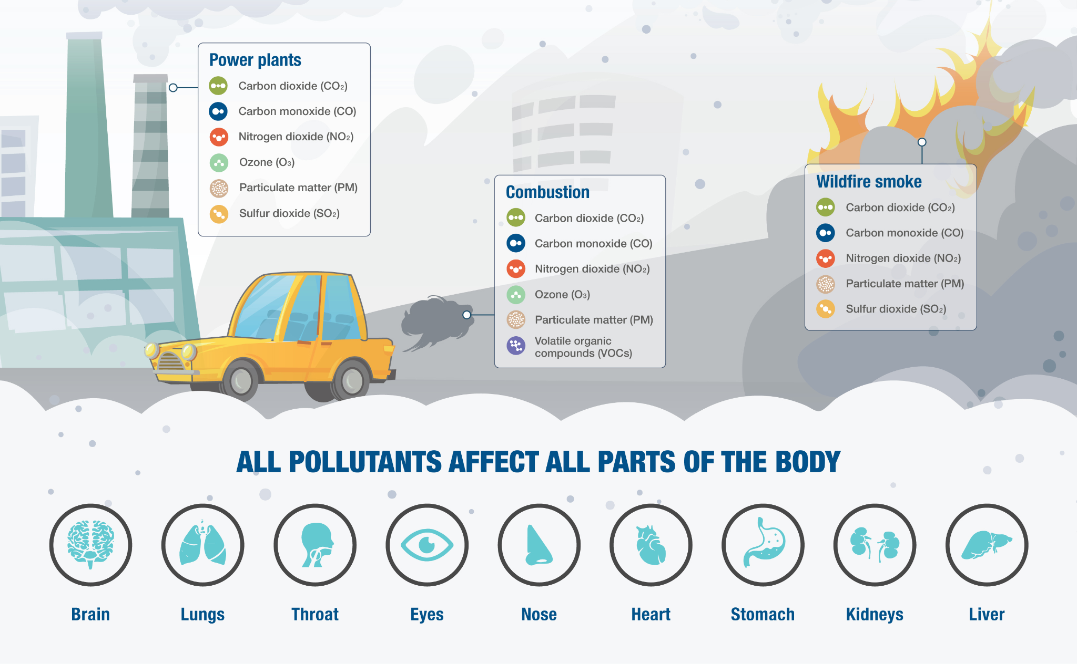
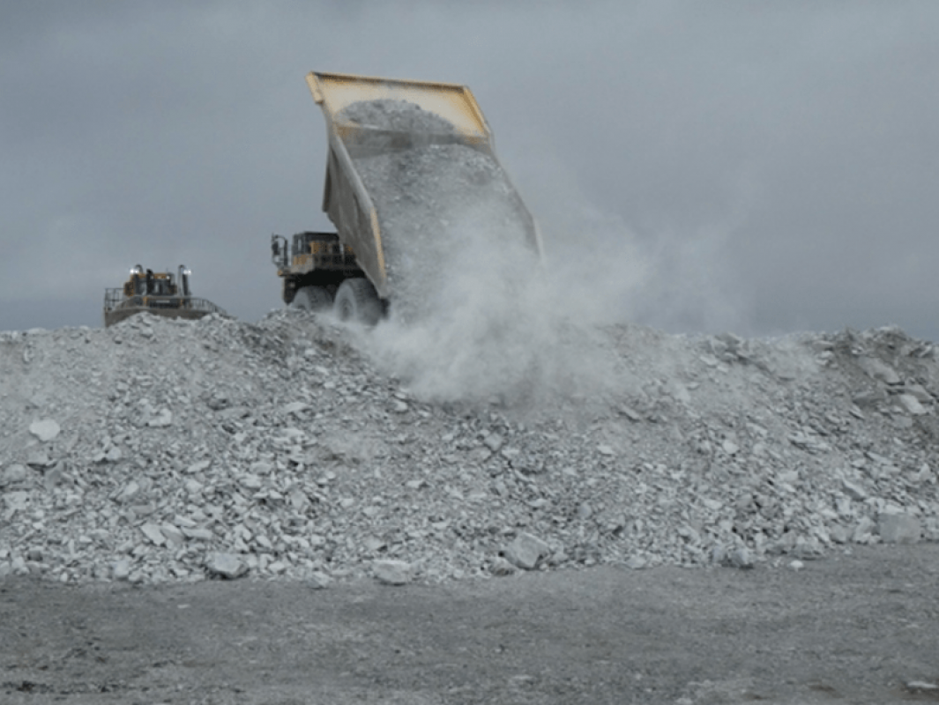
What are we measuring?
Also dust!

Slide 8
What are we measuring?
Combustion
NO
CO
NO₂
PM₁
Photochemical
Dust/sea spray
PM_{2.5}
O₃
PM₁₀
Also: NO_{x}:CO ratio

Slide 9
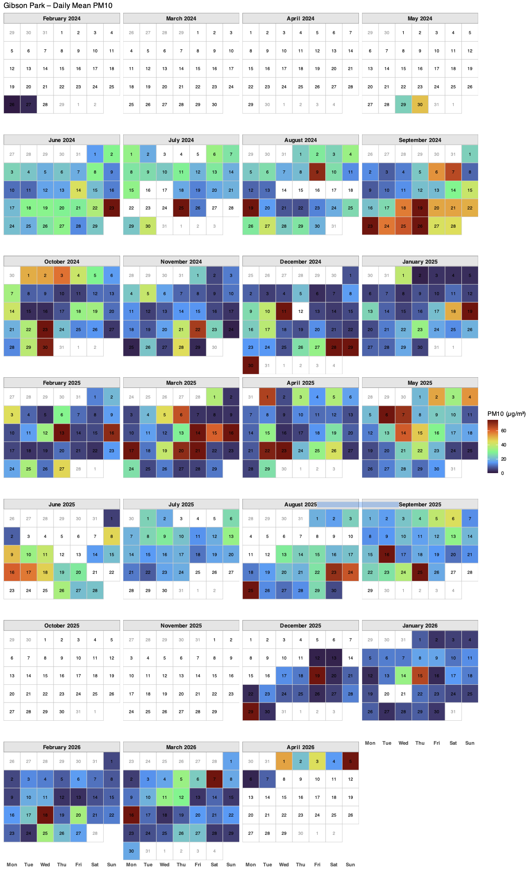
When was air pollution bad?

Slide 10
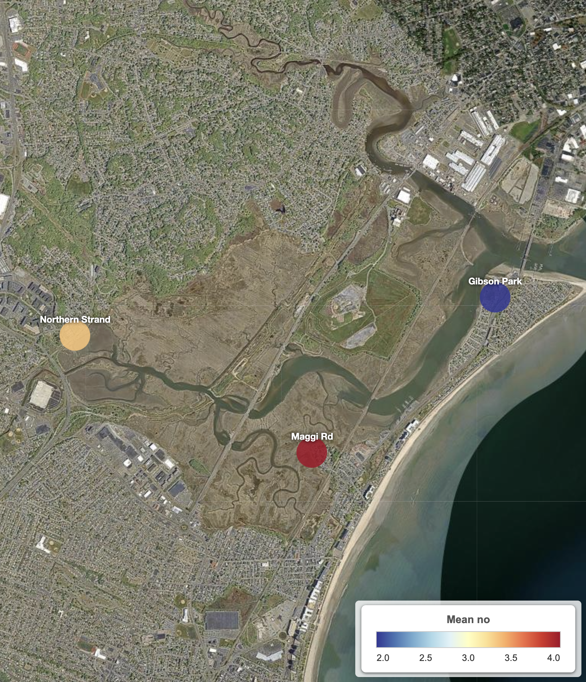
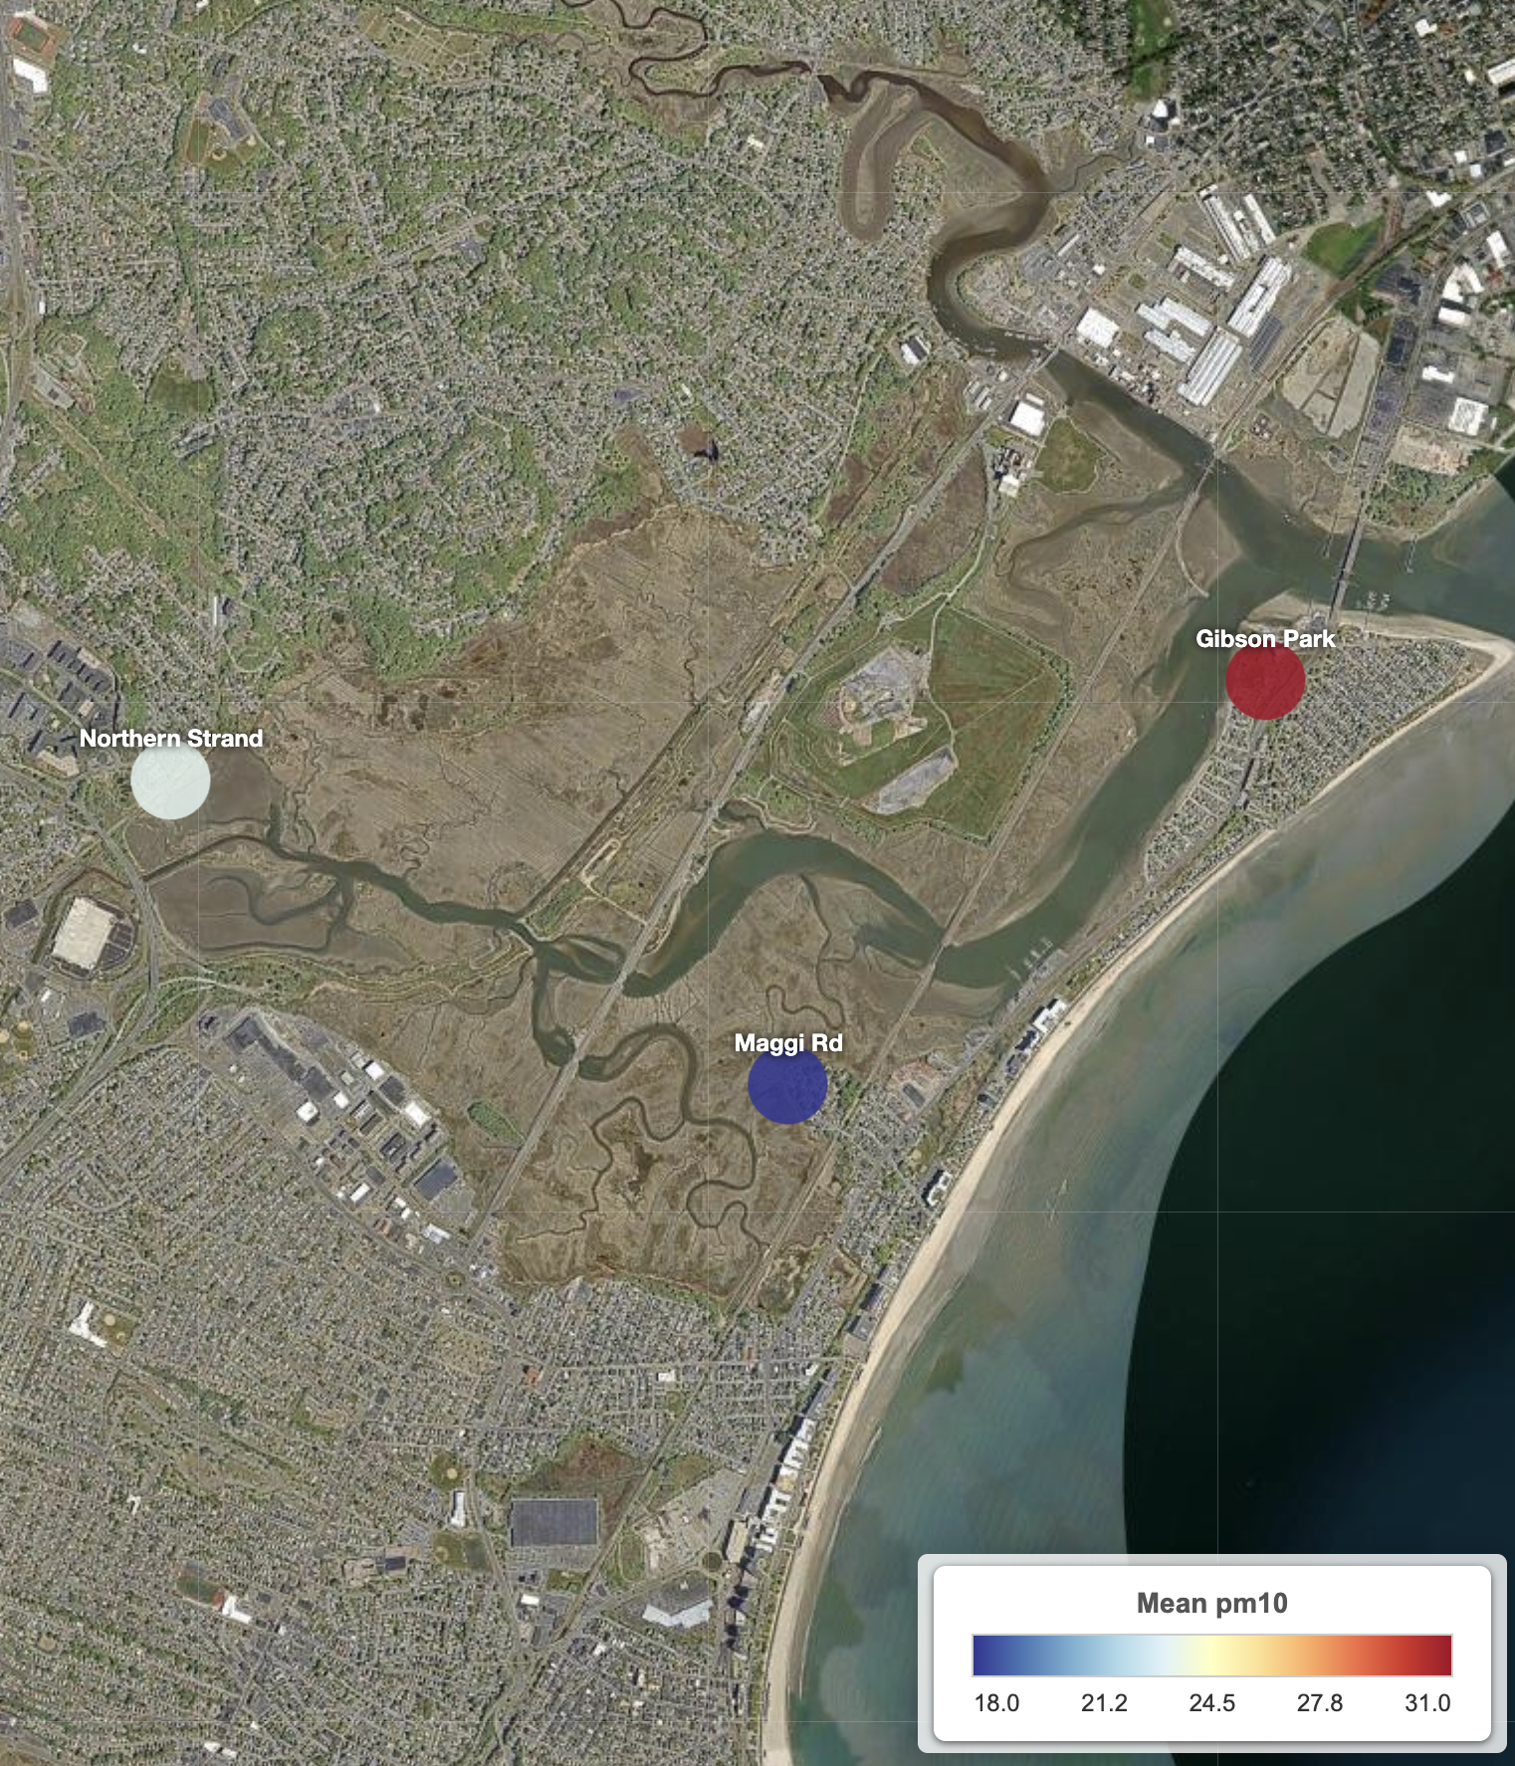
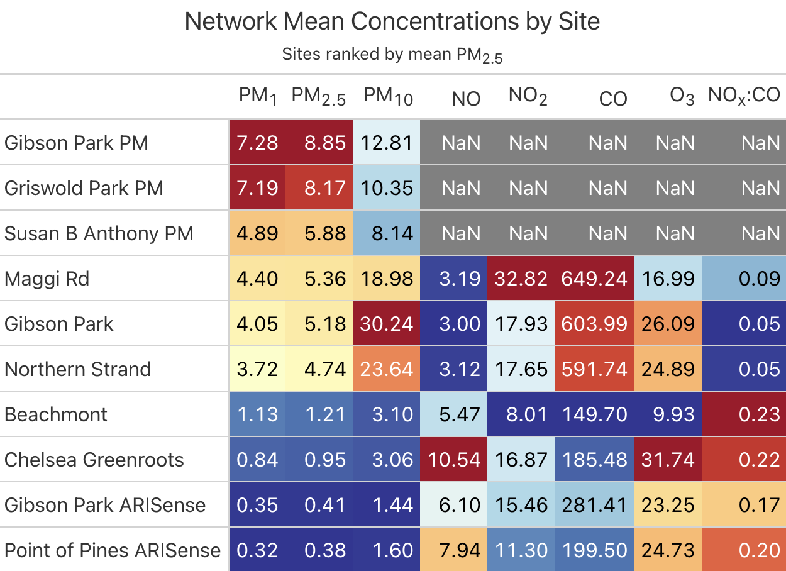
Where was air pollution bad?

Slide 11
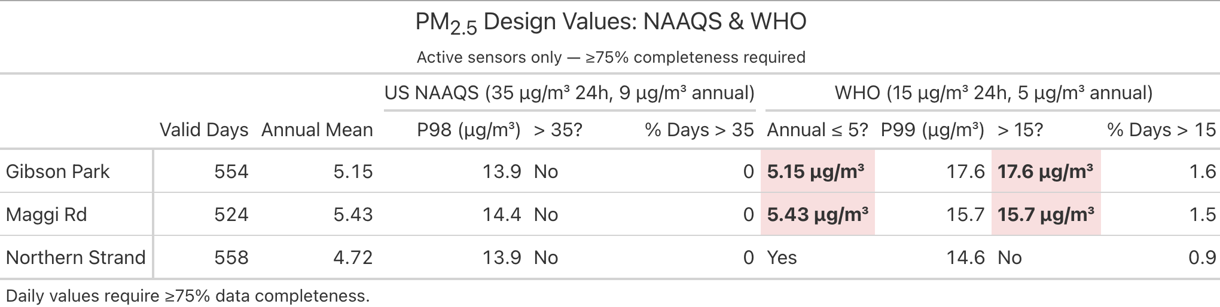
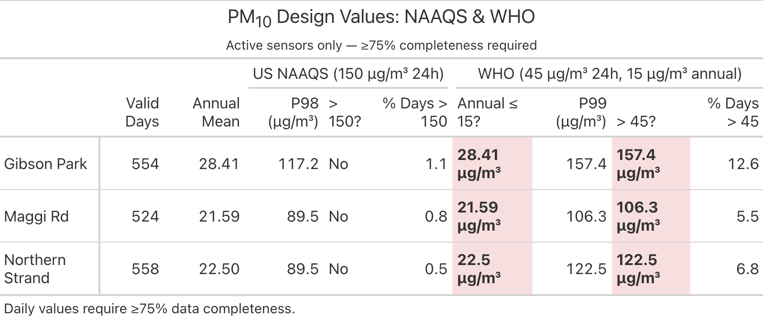
Do concentrations exceed NAAQS and WHO guidelines?

Slide 12
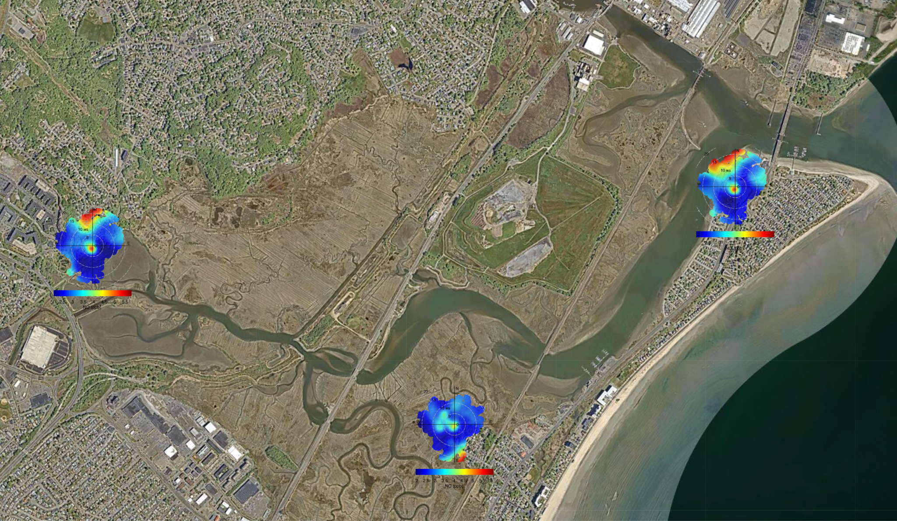
Where is air pollution coming from? (NO)
Notes:
We confirmed NOx input from

Slide 13
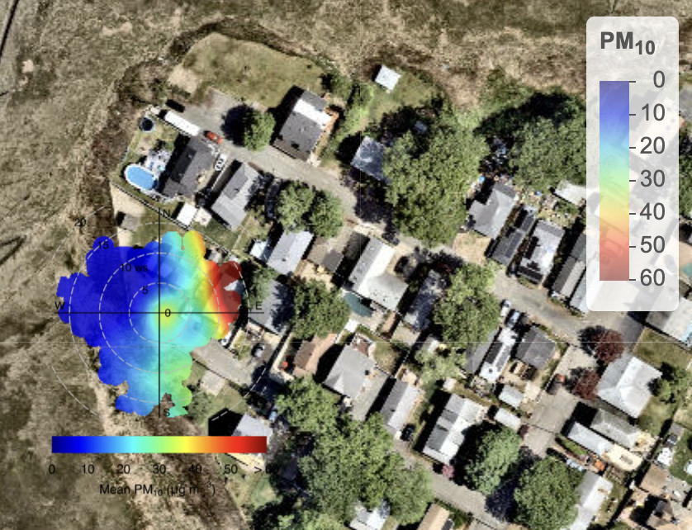
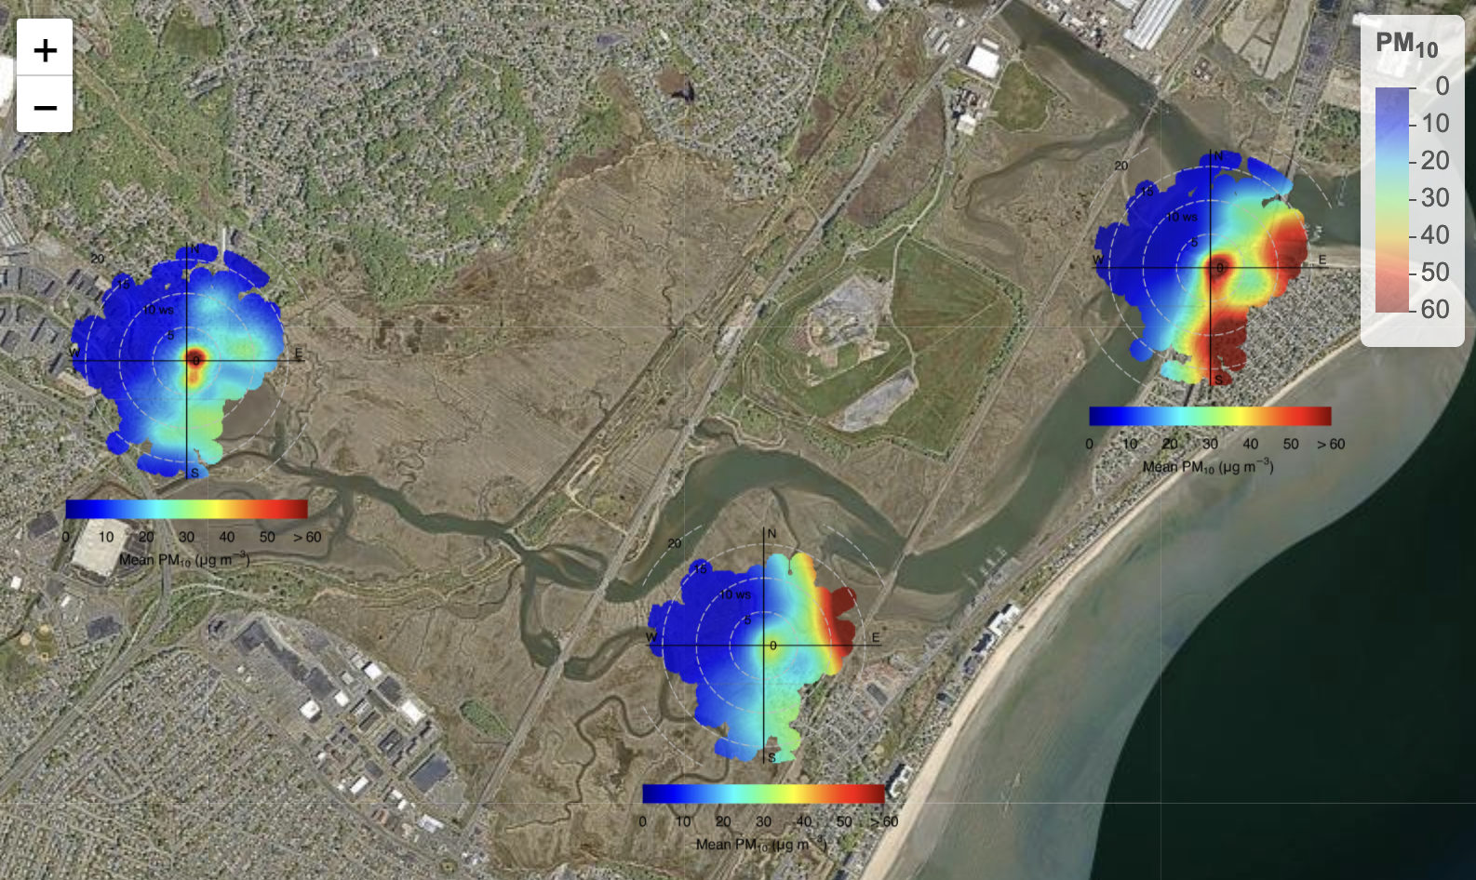
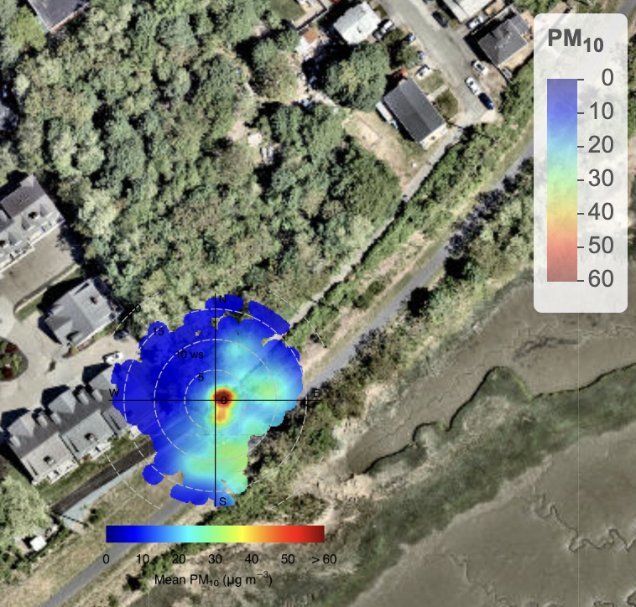
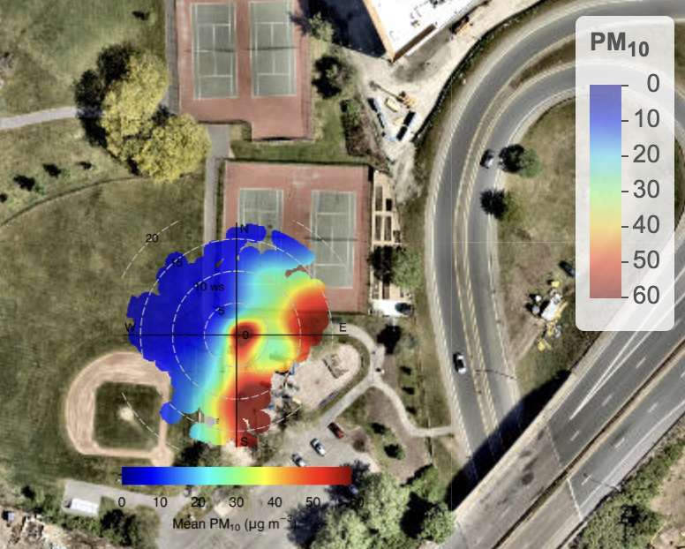
Where is air pollution coming from? (PM₁₀)

Slide 14
Next steps
Dig deeper into the data
Generate insights
Create a detailed report and share it
But first: tell us what you want to learn!

