Slide 1


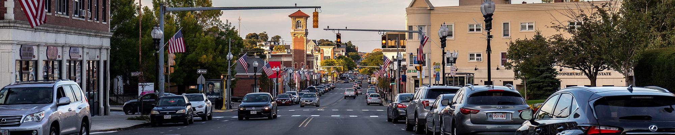
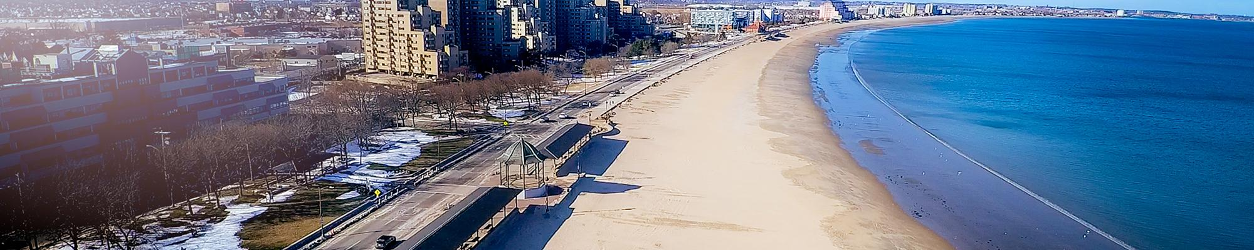
City of Revere
Hazard Mitigation Plan Update
City of Revere, MA
Hazard Mitigation Plan Update
2021
Public Stakeholder Meeting #1
March 3, 2021
6:00 pm – 7:30 pm
Office of Strategic Planning & Economic Development
Virtual Meeting
Stakeholder Meeting #2
Final Review and Comment
October 7, 2021
6:00 PM – 7:00 PM
Office of Planning & Development
Virtual Meeting

Slide 2

Local Hazard Mitigation Planning Committee
Elle Baker, Open Space and Environmental Planner
Frank Stringi, City Planner
Paul Argenzio, Superintendent DPW
Don Ciaramella, Chief of Infrastructure
Joe Maglione, Water, Sewer and Drain
Nick Rystrom, City Engineer
Chief Bright, Revere Fire Department
Captain Robert Fortuna, Revere Fire Department
Chief Callahan, Chief of Police
Nick Moulaison, Chair Conservation Commission
Dr. Diane Kelly, Superintendent-Revere Public Schools
Tech Leng, Director of Revere Planning and Development
Mike Hinojosa, Director of Parks and Recreation
Dean Harris, Revere Housing Authority
Ralph Decicco, Chair, Commission on Disabilities

Slide 3
Public Stakeholder Meeting No. 2 Agenda
Welcome and Opening Remarks……………………………………….City of Revere
Mitigation Planning and Plan Updates….……………….…………………….AECOM
Project Timeline…………………………..………………………………………...AECOM
Participation Requirements……………………..…….…………………….…..AECOM
2021 Revere Hazard Mitigation Plan Update………………………............AECOM
Adjourn
Wrap-up…..………………………………………………..…………..……City of Revere
Why is Hazard Mitigation Important?...................................................AECOM
General Discussion/Q&A………………………………………………...City of Revere
Stakeholder Engagement……………...…………..…..…………………….…..AECOM

Slide 4
Why is Hazard Mitigation Important?
.
    Revere is vulnerable to a variety of hazards ranging from floods, hurricanes, and severe winter weather to storms, extreme winds, and heat waves.
    The magnitude of a disaster depends on the intensity of the event, the number of people and structures exposed, and the effectiveness of pre-disaster mitigation actions in protecting people and property.

Slide 5
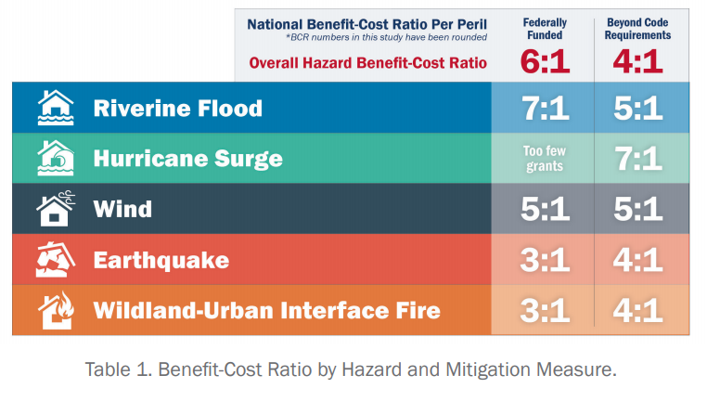
Why is Hazard Mitigation Important?
Updated study by the Multi-Hazard Mitigation Council (part of the National Institute of Building Sciences):

Slide 6
Mitigation Planning and Plan Updates
  Disaster Mitigation Act of 2000 (DMA 2000):
    Continued requirement for a State mitigation plan as a condition of disaster assistance
    Established a new requirement for local mitigation plans as a condition to be eligible for FEMA Hazard Mitigation Assistance (HMA)
    2018 Massachusetts State Hazard Mitigation and Climate Adaptation Plan
    Local plans should address updated hazards in the State plan
    2018 State plan also incorporates climate change

Slide 7
Project Timeline
    Key Checkpoints Include:
    January 2021 Local HMP Committee Meeting #1
    March 2021 Public Stakeholder Meeting #1
    April 2021 Local HMP Committee Meeting #2
    September 2021 Draft Updated HMP
    September 2021 MEMA/FEMA Review Draft HMP Update
    October 2021 Public Stakeholder Meeting #2
    TBD MEMA/FEMA Revised HMP Update
    TBD Adoption by City Council

Slide 8
Participation Requirements
    Members of the hazard mitigation planning team include:
  Those who participated in the development of the 2015 Plan
  Community leaders
  Neighborhood groups and other non-profit organizations and associations
  Regional and local government agency representatives
  Businesses and development organizations and business owners/operators
  Elected officials
  Interested citizens

Slide 9
Stakeholder Engagement
    Must include:
    Neighboring communities
    Local and regional agencies involved in hazard mitigation activities
    Agencies that have authority to regulate development
    Other interested parties:
    Non-profit organizations (i.e., Red Cross, Salvation Army)
    Environmental groups
    Historic preservation groups
    Church organizations
    Parks organizations
    State, federal, and local government offices
    Business and development organizations
    Transportation entities
    Emergency service providers
    Academic institutions
    Utility providers
    Hospitals
    Tribal groups
    Large businesses
    Regional planning organizations

Slide 10
2021 Revere Hazard Mitigation Plan Update
  History of Hazard Mitigation Plans in Revere:
    Requirement to comply with DMA 2000
    Initial Plan – 2005
    First Plan Update – 2015
      Updated hazard areas and development trends
      Some ongoing and some new mitigation measures
    Second Plan Update – 2021 (anticipated)
      Address climate-based hazards included in the 2018 MA State Hazard Mitigation and Climate Adaptation Plan
      Review and comment on previous mitigation actions
      Identify any new hazards/mitigation actions

Slide 11
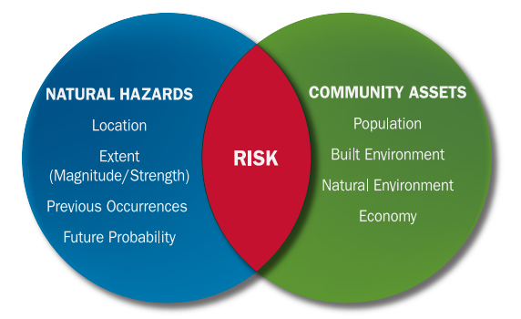
2021 Revere Hazard Mitigation Plan Update
Updated Risk Assessment
  Risk Assessment
  Potential for damages created by the interaction of natural hazards and the community.
  Provides the factual basis for activities proposed in the strategy to reduce losses from identified hazards.
  Local risk assessments must provide information to identify and prioritize mitigation actions to reduce losses from identified hazards.
Source: FEMA, 2013
  Provides a foundation for the community’s decision makers to evaluate mitigation measures that can help reduce the impacts of a hazard when one occurs.

Slide 12
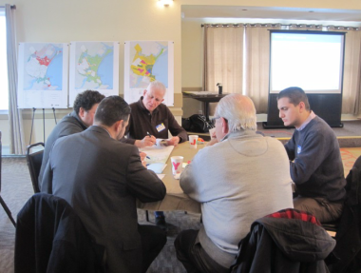
2021 Revere Hazard Mitigation Plan Update
Updated Risk Assessment
  Regular updates of the risk assessment ensure:
That the plan remains applicable to present-day understanding of vulnerabilities based on most recent assessments, development patterns, and community experiences.
That the plan continues to present the best path forward for reducing future damages when natural hazards inevitably occur.
Promotes participation and community buy-in.
Source: Revere MVP Summary of Findings Report

Slide 13
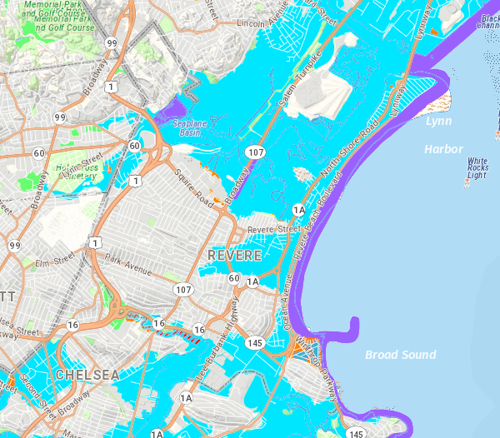
2021 Revere Hazard Mitigation Plan Update
Updated Risk Assessment
  Notable assessments and changes since 2015 update:
  Assessments
    FEMA defined Special Flood Hazard Area (SFHA) updated in 2017.
    Revere Municipal Vulnerability Preparedness (MVP) Summary of Findings Report.
  Changes
  Natural hazards assessed through the context of climate change.
  Incorporated data from FEMA’s National Risk Index into each hazard profiled (where data is available).
Revere SFHA. Source: Mass GIS
Notes:
Included context of climate change to demonstrate the connections between traditional natural hazards analysis and climate change projections.
Includes following interactions: Changes in precipitation, sea level rise, rising temperatures, and extreme weather.

Slide 14
2021 Revere Hazard Mitigation Plan Update
Updated Risk Assessment
  Changes in hazards profiled since 2015 Plan
Primary Climate Change Interaction | Hazard | Previously Identified As
Changes in Precipitation | Inland Flooding | River flooding (under flood related hazard)
 | Drought | Drought
 | Landslides | Landslide (under geologic hazard)
Sea Level Rise | Coastal Flooding | Coastal flooding (under flood related hazard)
 | Coastal Erosion | Coastal erosion (under flood related hazard)
 | Tsunamis | Tsunami (under flood related hazard)
Rising Temperatures | Extreme Temperatures | Extreme temperatures
 | Wildfires | Wildfires
 | Invasive Species | NEW
Extreme Weather | Hurricanes/Tropical Storms | Hurricanes (wind related hazard)
 | Severe Winter Storms | Winter storms
 | Tornadoes | Tornadoes (under wind related hazards)
Non-Climate Influenced Hazards | Earthquakes | Earthquakes (under geologic hazard)
Notes:
Limited changes to the hazards profiled, organization of hazards has been updated to reflect the context of climate change.

Slide 15
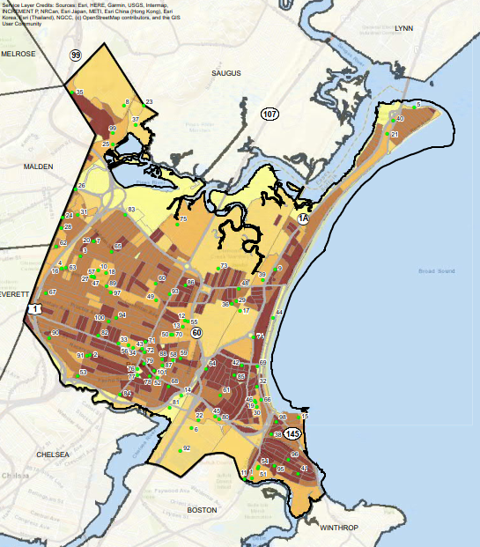
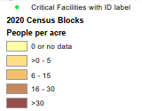
2021 Revere Hazard Mitigation Plan Update
Updated Risk Assessment: Population Density

Slide 16
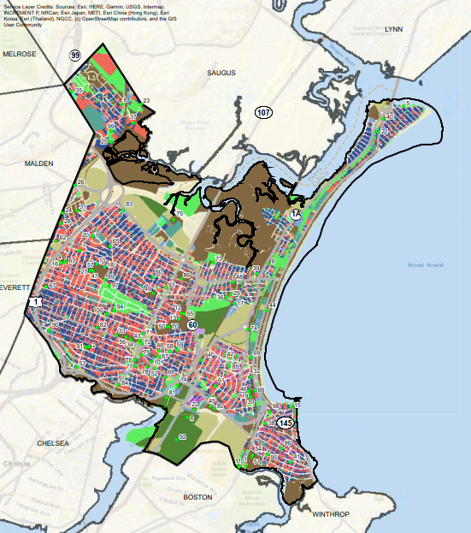
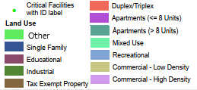
2021 Revere Hazard Mitigation Plan Update
Updated Risk Assessment: Land Use

Slide 17
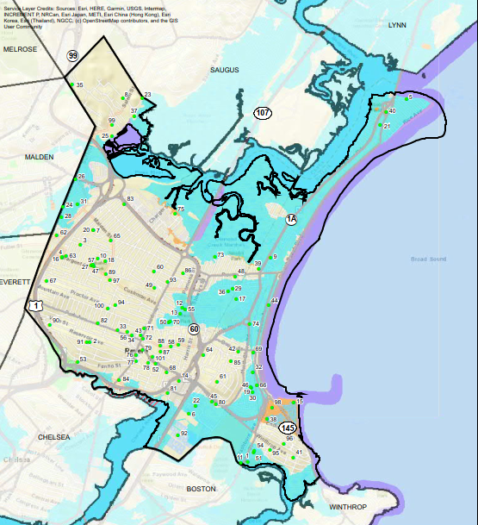
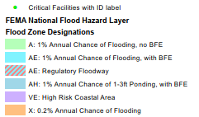
2021 Revere Hazard Mitigation Plan Update
Updated Risk Assessment: Flood Risk

Slide 18
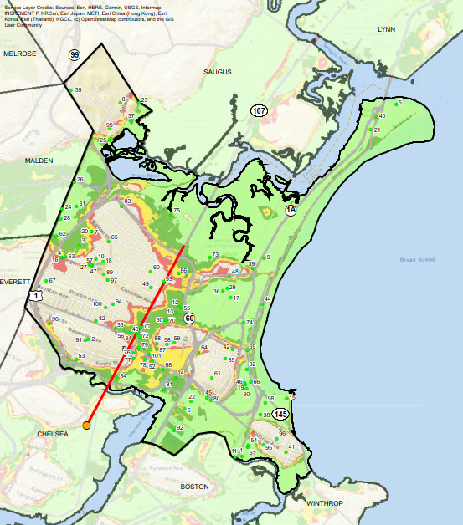
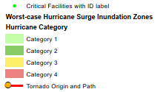
2021 Revere Hazard Mitigation Plan Update
Updated Risk Assessment: Storm Surge

Slide 19
2021 Revere Hazard Mitigation Plan Update
Updated Risk Assessment: Vulnerability
  Summary of impacts and vulnerability
Hazard | Impacts | Vulnerability
Changes in Precipitation
Inland Flooding | Damage to buildings and infrastructure | Low-lying areas Land in the SFHA West/North Revere Sales Creek area
Drought | Agricultural production and water access | Residents on private water supply (not a concern in Revere)
Landslides | Damage to buildings and infrastructure | Entire City
Sea Level Rise
Coastal Flooding | Damage to buildings and infrastructure | Low-lying coastal areas Beachmont Point of Pines/Riverside Oak Island/Revere Beach
Coastal Erosion | Increases vulnerability of residents further from to coast to coastal flooding | Residents adjacent to coastline
Tsunamis | Damage to buildings and infrastructure | Residents adjacent to coastline

Slide 20
2021 Revere Hazard Mitigation Plan Update
Updated Risk Assessment: Vulnerability
  Summary of impacts and vulnerability (continued)
Hazard | Impacts | Vulnerability
Rising Temperatures
Extreme Temperatures | Public health Access to lifeline utilities such as electricity and potable water | Entire city Emphasis on low-income and elderly residents
Wildfires | Damage to buildings | Residents most adjacent to shrubland and MBTA lands
Invasive Species | Rarely impact humans directly | Entire City
Extreme Weather
Hurricanes/Tropical Storms | Damage to buildings and infrastructure | Entire City is vulnerable to hurricane winds Low-lying coastal areas are most vulnerable to storm surge
Severe Winter Storms | Inhibit travel Power outages Structure fires | Entire city Emphasis on low-income and elderly residents
Tornadoes | Damage to buildings and infrastructure | Entire City
Non-Climate Influenced Hazards
Earthquakes | Damage to buildings and infrastructure | Entire City

Slide 21
2021 Revere Hazard Mitigation Plan Update
Updated Strategy
  Mitigation Goals
Number | Description
1 | Ensure that critical infrastructure sites are protected from natural hazards
2 | Protect existing residential and business areas from flooding.
3 | Make efficient use of public funds for hazard mitigation.
4 | Continue to enforce zoning and building regulations.
5 | Educate the public about zoning and building regulations, particularly with regard to changes in regulations that may affect teardowns and new construction.
6 | Encourage future development in areas that are not prone to natural hazards.
7 | Educate the public about natural hazards and mitigation measures.
8 | Protect the City's ability to respond to various natural hazard events.

Slide 22
2021 Revere Hazard Mitigation Plan Update
Updated Mitigation Actions
New actions identified through the City’s MVP planning process:
Conduct a city-wide drainage study
Identify a liaison between the City and State to identify and secure funding and increase communication
Investigate permitting and regulatory process for sand transfer to mitigate coastline erosion
Mitigate the impact of development and redevelopment by requiring best management practices for stormwater management and incentivizing green infrastructure and green building technologies
Improve the City's drainage system based on findings of the city-wide drainage study

Slide 23
2021 Revere Hazard Mitigation Plan Update
Updated Mitigation Actions
New actions identified through the City’s MVP planning process (continued):
Improve communication with public and educate public about evacuation plans and natural hazards
Develop multilingual resources to aid in public education efforts

Slide 24
2021 Revere Hazard Mitigation Plan Update
Updated Mitigation Actions
New actions identified for the 2021 plan by Local HMP Committee and stakeholders:
Upgrade the Point of Pines pump station and pump
Add new drainage outfall from Malden Street/Washington Avenue area to the Town Line Brook
Increase the city’s tree canopy to reduce heat island effect
Complete Oak Island marsh restoration efforts within east and west sides of Route 1A (marshland acquisition required)
Beach nourishment and erosion control for Revere Beach
Beach nourishment and dune restoration for Point of Pines
Ambrose Park drainage improvements included with park reconstruction

Slide 25
2021 Revere Hazard Mitigation Plan Update
Updated Mitigation Actions
New actions identified for the 2021 plan by Local HMP Committee and stakeholders (continued):
Drainage improvements under Route 1A
Route 95 embankment / marsh restoration
Riverfront Master Plan stormwater management and resilience recommendations
Preliminary recommendations from Point of Pines / Riverside Area Coastal Resilience Feasibility Study
Purchase highwater fire trucks
Expand Point of Pines sewer pump station wet well

Slide 26
2021 Revere Hazard Mitigation Plan Update
Updated Mitigation Actions
New actions identified for the 2021 plan by Local HMP Committee and stakeholders (continued):
Advocate for ACOE’s Regional Flood Protection Project
Reinforce Winthrop Parkway Seawall
A total of 48 actions included in the 2021 plan.

Slide 27
General Discussion / Q&A
Questions and Discussion?

Slide 28
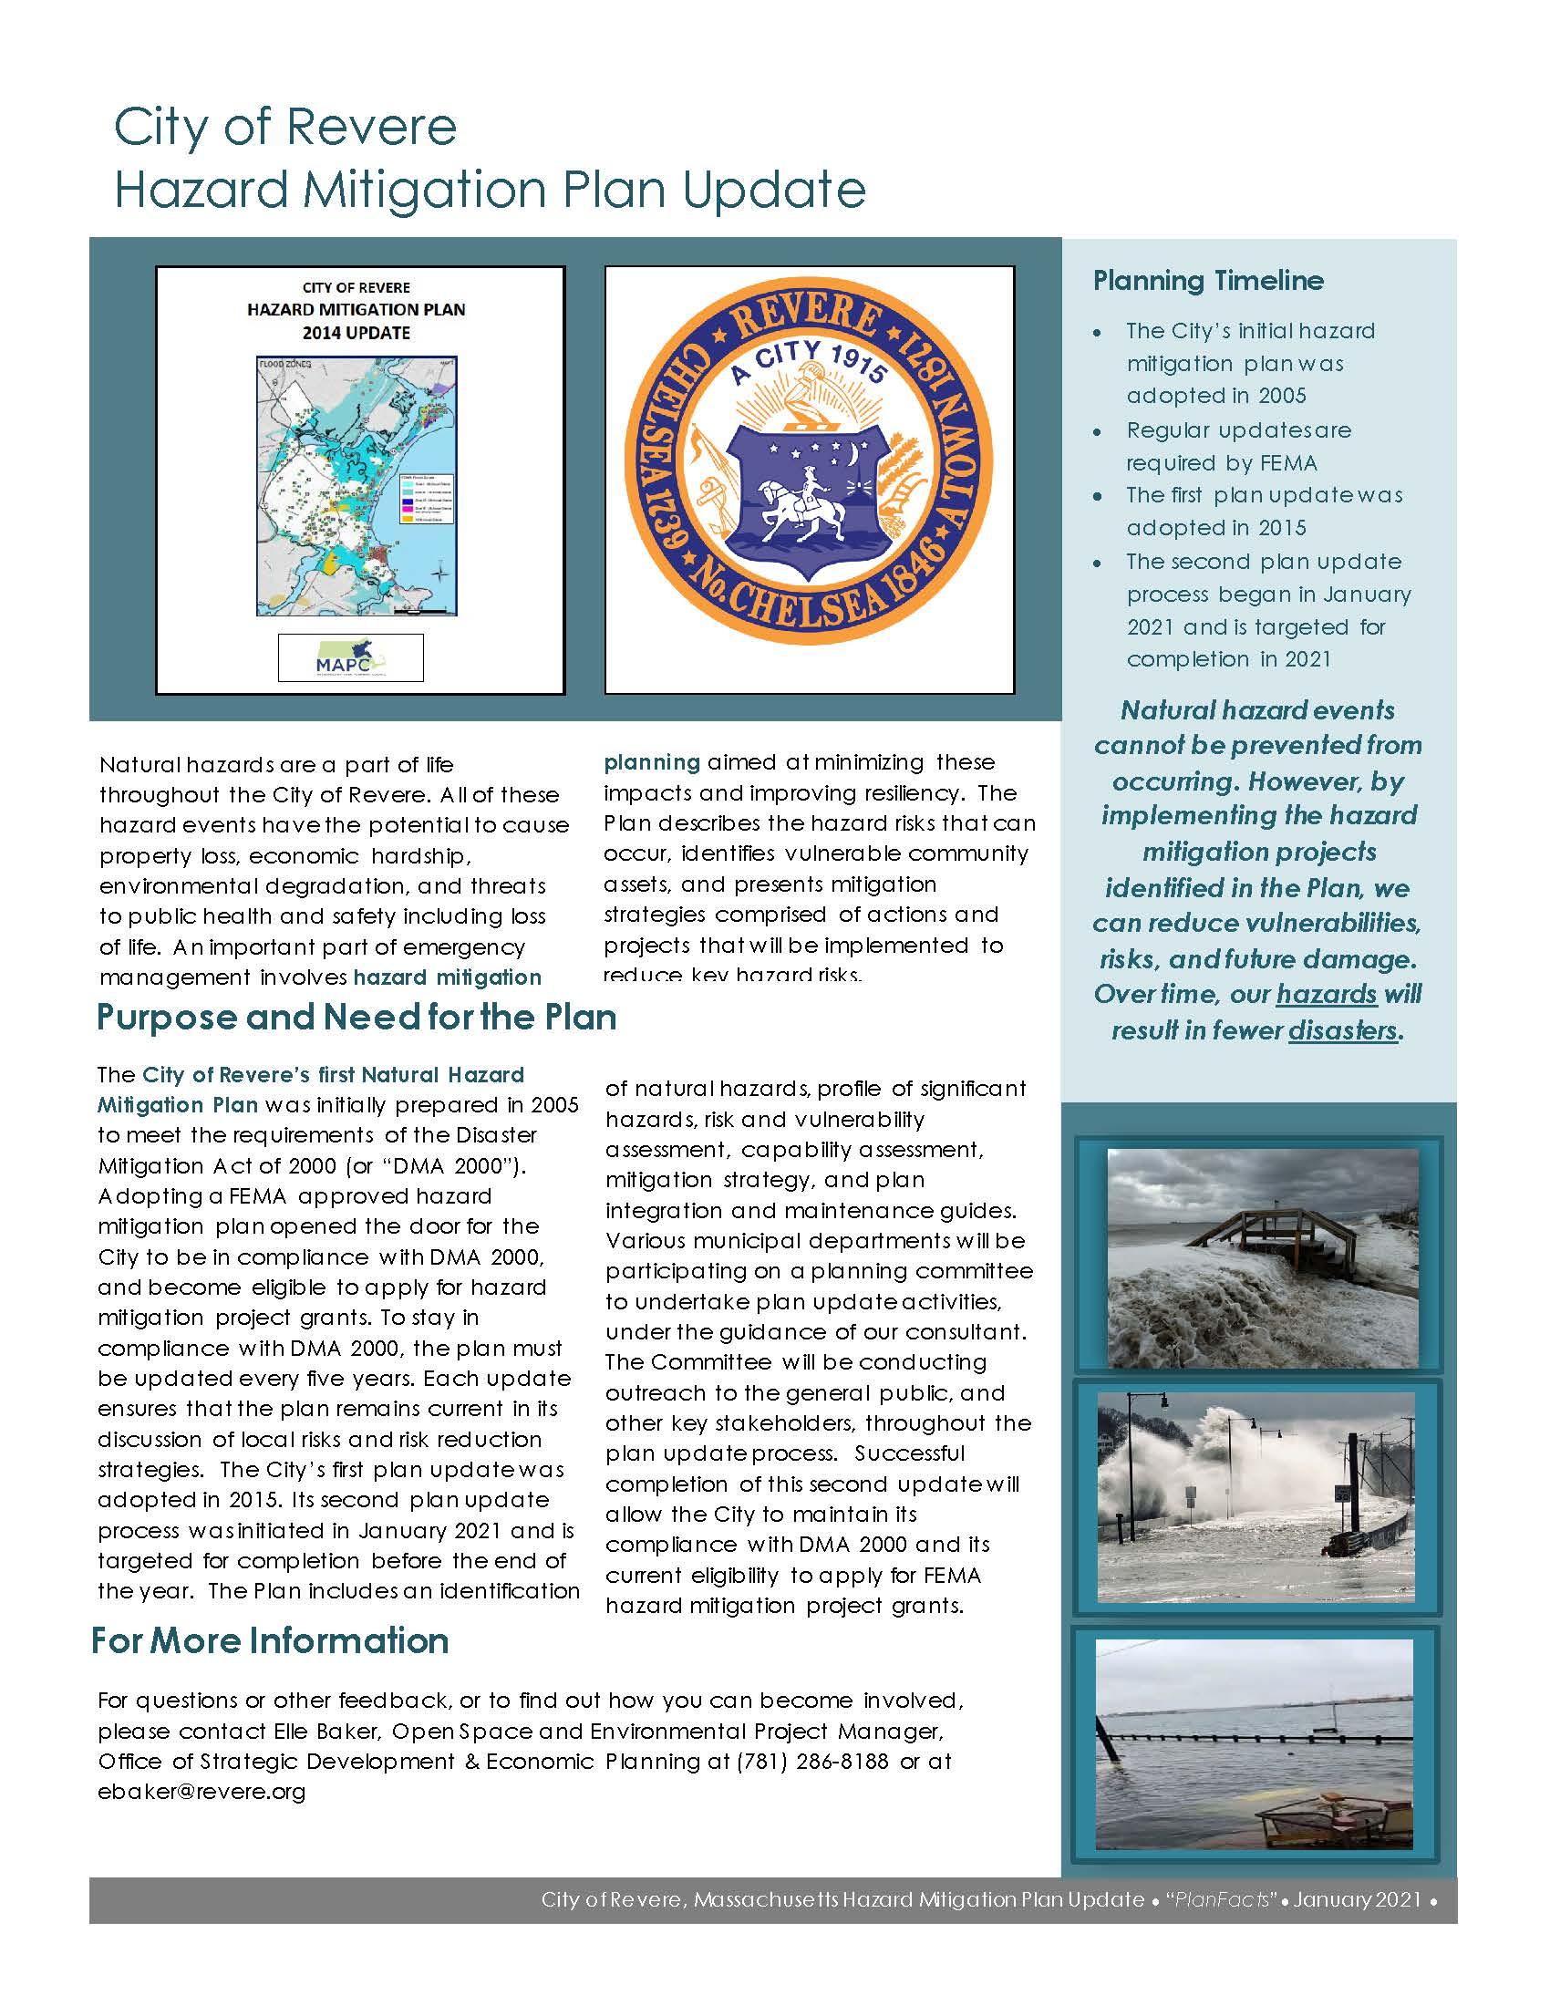
Wrap-Up
For more information, please contact:
Office of Planning & Development:
Elle Baker, 781-286-8188
AECOM:
Aaron Weieneth, 617-251-8304
City’s Website: https://www.revere.org/

